Slide 1
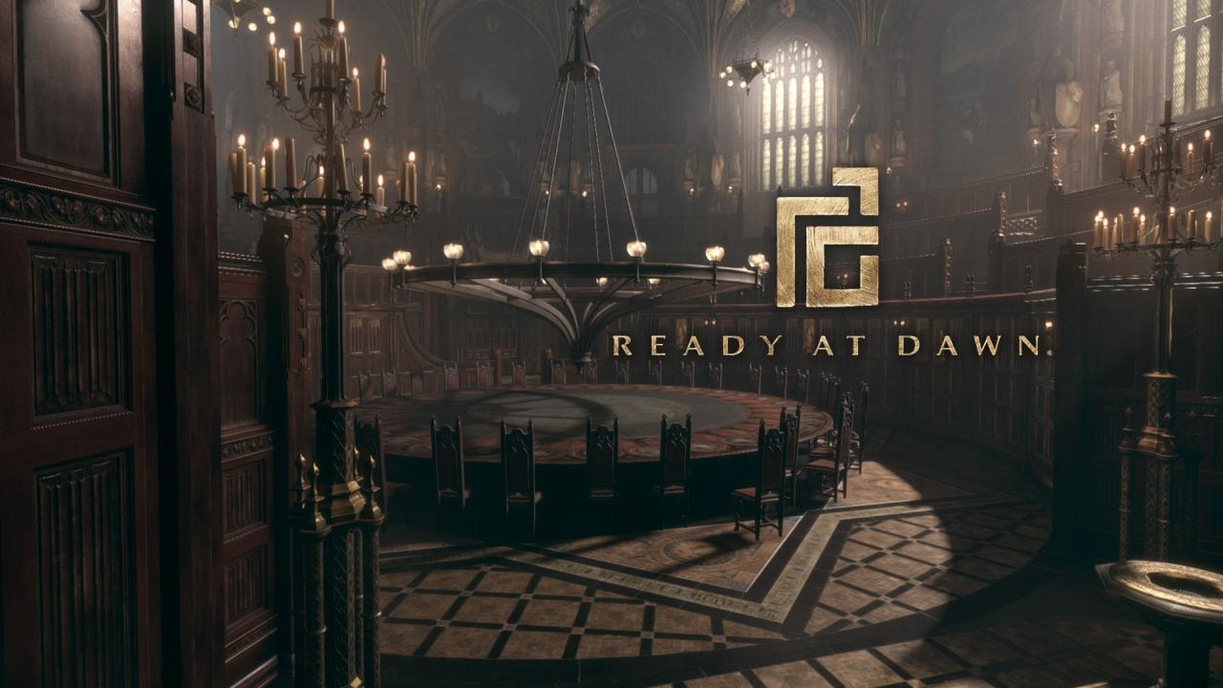

Slide 2
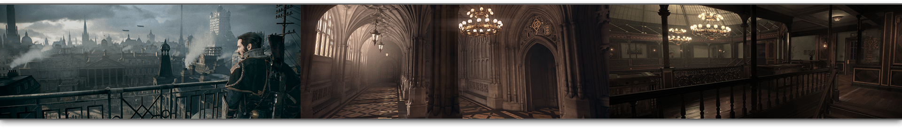
Crafting Victorian London: The Environment Art and Material Pipelines of The Order: 1886
Nathan Phail-Liff, Art Director, Ready at Dawn Studios
Anthony Vitale, Lead Environment Artist, Ready at Dawn Studios

Slide 3
Topics Covered
Materials and Environment Art
Overview of Material System
Environment compositing and layer Blending
Environment Modeling Techniques
Lighting and Rendering
Post Processing and Lighting
Volumetric Lighting
Baking
Notes:
Just to give everyone a quick overview on the topics covered in the first half of our art production talk, we’ve broken the environment talk into two primary areas of focus.
In the first portion, Tony and I will be focusing mostly on our material pipeline and various environment modeling and surfacing techniques
[CLICK]
And after that I will go over some of our lighting tech, particularly as it pertains to environments

Slide 4




Company Overview
Founded in 2003
Developed Daxter, God of War: Chains of Olympus, and God of War: Ghost of Sparta for the PSP
2006
2008
2010
2015
Notes:
Before we get into things, I’m just going to touch on very briefly on our company and the challenges of the current project.
RAD was founded in 2003 and is based in Irvine, California.
And prior to The Order: 1886, we were known for primarily as a PlayStation Portable developer, creating original games for some of the big Sony franchises, such as Jak and Daxter and God of War.

Slide 5

The Order: 1886
Development began at start of 2011
Company size of 45 at start
Peaked at about 140
Biggest Challenges
Skipped 2 generations of hardware
Engine, tools, and physics from scratch
Our first original IP
Completely new gameplay genre
New art style
Everything real-time, in-game
Notes:
And then we jumped off the deep end with The Order: 1886.
We started development at the very beginning of 2011. There were about 45 people in the entire company at that point and by the very height of production we peaked at about 140.
We also faced a few challenges with this game
[CLICK]
We were jumping from the PSP directly to the PS4, still early in development
All of our tools, engine, and even physics were all developed in-house and from scratch
This was our first original ip
And in a genre completely new to us as developers
Also we were exploring a completely new art style, with dramatically higher level of detail and realism
Everything was to be real-time, in-game, from the start menu to the closing credits. This also meant no higher quality cinematic assets. Everything would be running live on the PS4 with in-game content.

Slide 6
Pre-Production Environment Pipeline Goals
Build art pipeline focused on inheritance and reuse
Produce unique, high quality content once
Allow it to be easily leveraged by the entire art team
Notes:
So pretty terrifying.
We realized that we were a relatively small team that had to bridge a pretty huge divide, and we felt we really needed to make some smart bets early on. Just to highlight a couple goals we had from the beginning, particularly regarding materials and environment art: [CLICK]
The first was to build a art pipeline focused on inheritance and reuse. This meant we wanted to find ways to be able to really polish core assets once, and then have them very easily accessible and reusable by the entire art team. [CLICK]

Slide 7
Pre-Production Environment Pipeline Goals
Build art pipeline focused on inheritance and reuse
Produce unique, high quality content once
Allow it to be easily leveraged by the entire art team
Advanced real-time materials and lighting
Achieve nuanced specular material response
Strong lighting and material balance
Advanced material layer blending
Notes:
Also, visually we wanted to achieve a rendering fidelity that generally not associated with games in the past, instead coming closer to pre-rendered CG. One particular area emphasis we had was attempting to capture a really accurate specular representation in materials and lighting. We also wanted to make sure that our lighting and material model were very balanced and worked to enhance, not detract form each other.
Finally, specifically with environment art, we also wanted to expand our toolset to be able to surface a hand crafted looking world, mostly from efficient, tile-able textures.
I’ll now show you guys a trailer we put together for SIGGRAPH showcasing some of our environments and characters. Hopefully this shows that we came pretty close to hitting some of these visual goals, especially considering it is all real-time and in-game on a console.

Slide 8
Trailer
Viewable online at:
_{https://youtu.be/8CnWazZpMeQ}

Slide 9
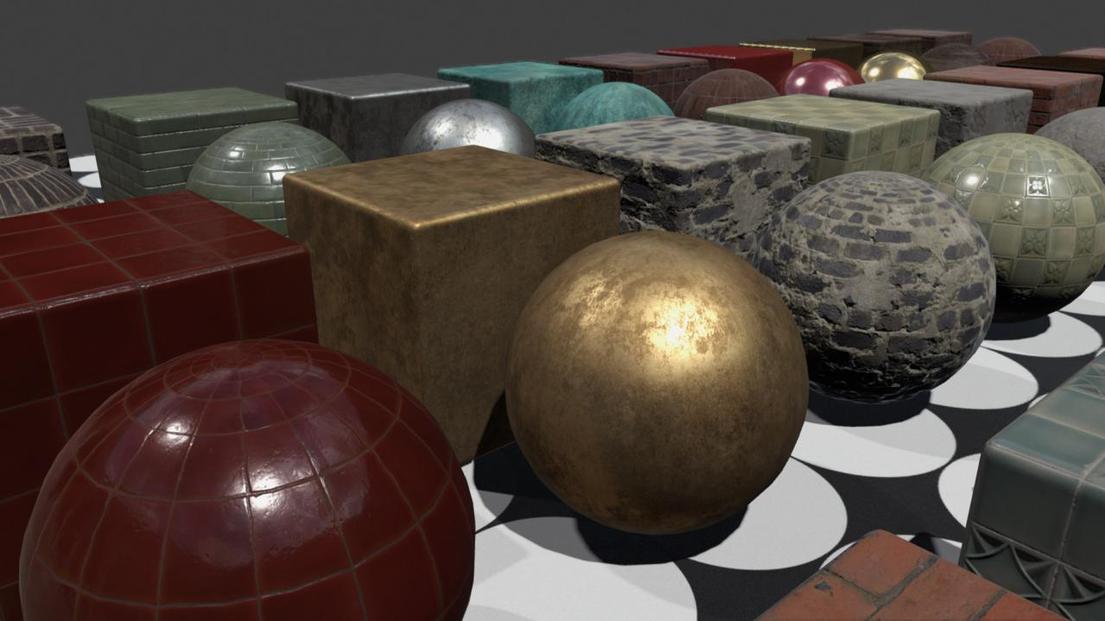
Material Pipeline
Notes:
So I think we developed a lot of cool tech and pipelines on this project, but I ‘d have to say one of our biggest successes was our material pipeline.
We put this concept in motion almost at the very beginning of the project, and it was a very different way of approaching things at the time. The end result helped improved the quality and consistency of visuals of the entire game, all while slashing content creation time to a fraction of more traditional techniques.

Slide 10
Material Pipeline Goals
Small number of templates drive shading response of entire game
Unbroken inheritance chain to a per-pixel level
Notes:
So just to touch on a few general goals.
[CLICK]
First off, we wanted to a pipeline where the smallest number of artist created templates could drive the shading response of the entire game, down to every pixel in a material.
[CLICK]

Slide 11
Material Pipeline Goals
Small number of templates drive shading response of entire game
Unbroken inheritance chain to a per-pixel level
Faster, better, and cheaper texturing process
Do away with unintuitive texture map authoring
Make high quality materials easily reusable
Optimized, fixed cost for any shading representation
Notes:
And we wanted to radically improve the texturing process.
Personally, I feel like creating shading utility maps, such as roughness, fresnel intensity, and specular is not a process that is very suited to a hand authored texture. An artist can make any one asset look great in isolation, but throw a much larger team into the mix, all authoring their own textures from scratch, and you will get a pronounced consistency and quality drift as production scales up.
To me an ideal system is where an artist can indicate:
‘I want metal here, it’s tarnished here, and dust builds up here’
It still is a highly creative process, just a little more intuitive than manipulating pixel intensities in a map

Slide 12
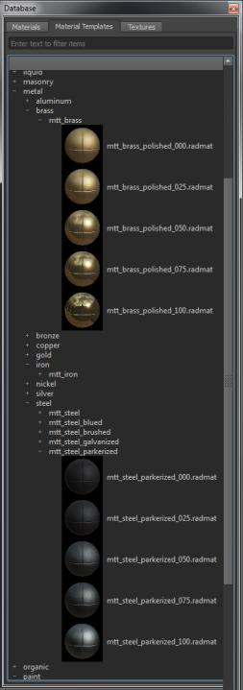
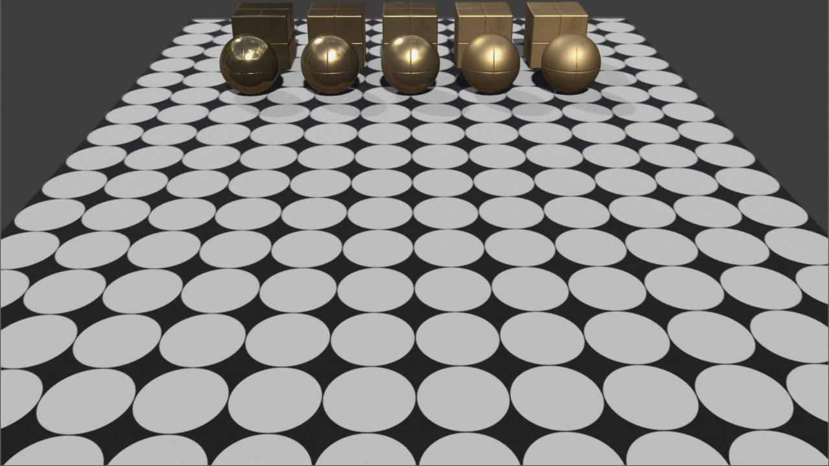
Material Templates
Template Guidelines
Defines clinical shading response only
Never used directly in game
Can be maintained by a single artist
Notes:
So how did we solve this problem?[CLICK]
First we setup rules for a database of material templates.
So, to us, templates only define clinical shading response of researched materials. We would put some basic color and spec maps on them for a baseline, put there was no artistic variation introduced to these.
[CLICK]
Templates would never go directly into game in any form. You’ll notice a cross bevel in the normal map material of all of our templates. This insured that no artist would accidently use them on a game asset.
[CLICK]

Slide 13
Material Templates
Template Guidelines
Defines clinical shading response only
Never used directly in game
Can be maintained by a single artist
Notes:
Lastly, templates were only maintained by one artist for shading consistency. With how our system worked, early on this was even manageable for me as a small part time job, and later, the same for Scot, when he took over as shading and texturing lead. This gave him plenty of time to spare, so we made him solve our character hair pipeline. Just to keep busy.
At any rate, sticking to these rules allowed us to rebalance the shading response of every pixel of every material in the entire game in a few days. It is not something I would recommend doing in the last week of production, but it is conceivably possible. But still stupid.

Slide 14
Material Templates
mtt_brass_polished_075
mtt_brass_polished_025
Template Naming
Concise, but technically accurate
Last word describes primary tuning variable
3 digit integer at end is 0-100 intensity of variable
Notes:
This slide here shows how we standardized naming of materials. We made sure every name was concise, and relatively accurate to the actual material. Any garbage name like ‘shiny metal’ would instantly be tossed out of the library.
The last word would be the modifier of the base type, generally some form of entropy like degree of polish on metals.
At the very end would be a 3 digit integer to integrate the scale of this modifier.

Slide 15
Material Templates
mtt_brass_polished_075
mtt_brass_polished_025
mtt_brass_polished_100
mtt_brass_polished_050
mtt_brass_polished_000
mtt_brass_polished_085
mtt_brass_polished_015
Template Naming
Naming convention allows inserting additional steps cleanly
Notes:
This was actually extremely helpful, as it allowed us to start with a small scale of variants, and insert additional steps as needed, without renaming materials or causing unexpected surprise other artists using the existing templates down the chain.
For this reason we never started with extremes. Generally 075 and 025 would be the baseline. [CLICK]
This left room to push above, below, and insert additional steps in between, if needed.

Slide 16
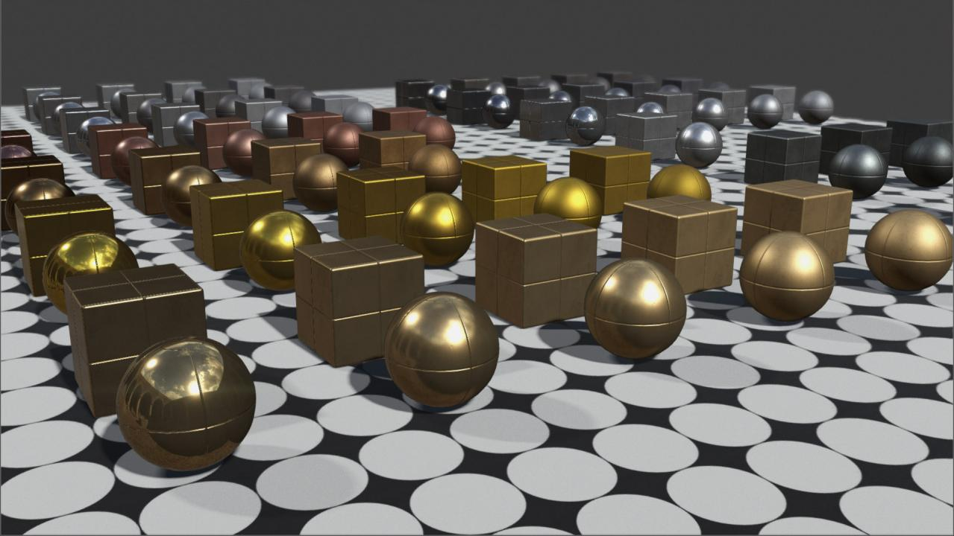
Material Template Samples
Metal
Notes:
I’ll just quickly flip through some template samples here. First up is a subset of our metals.

Slide 17
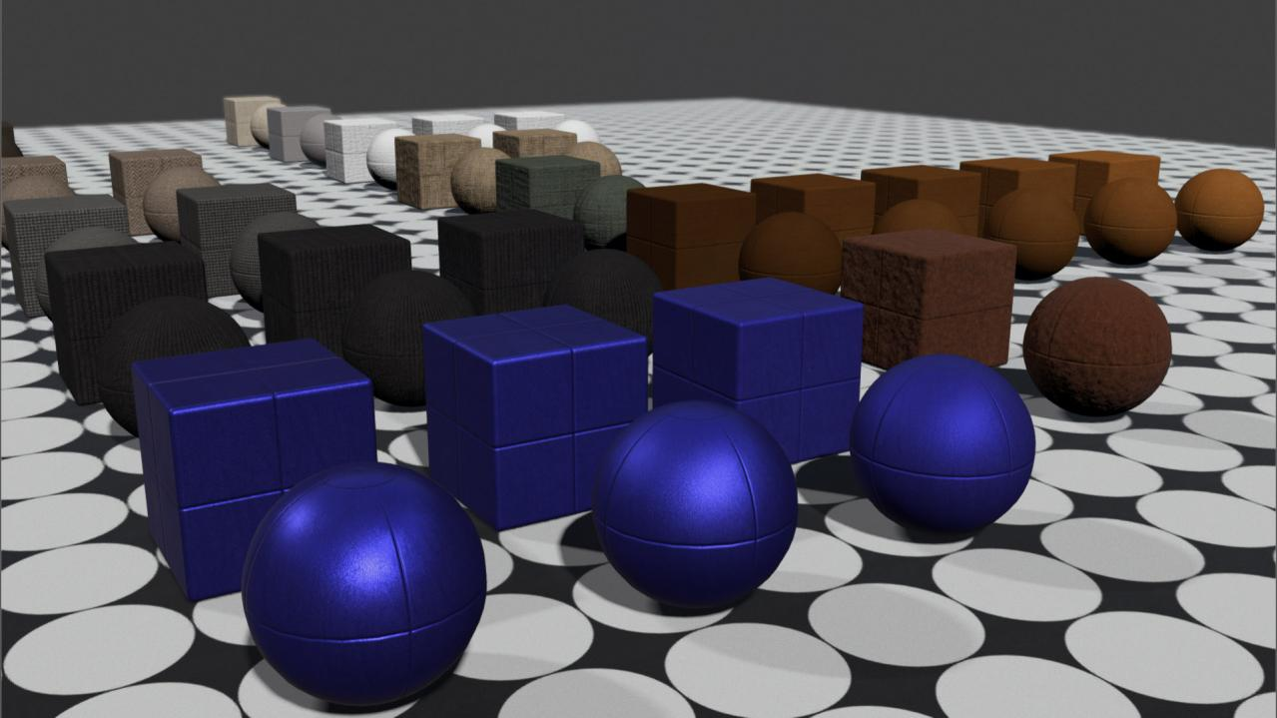
Material Template Samples
Textile
Notes:
And textiles

Slide 18
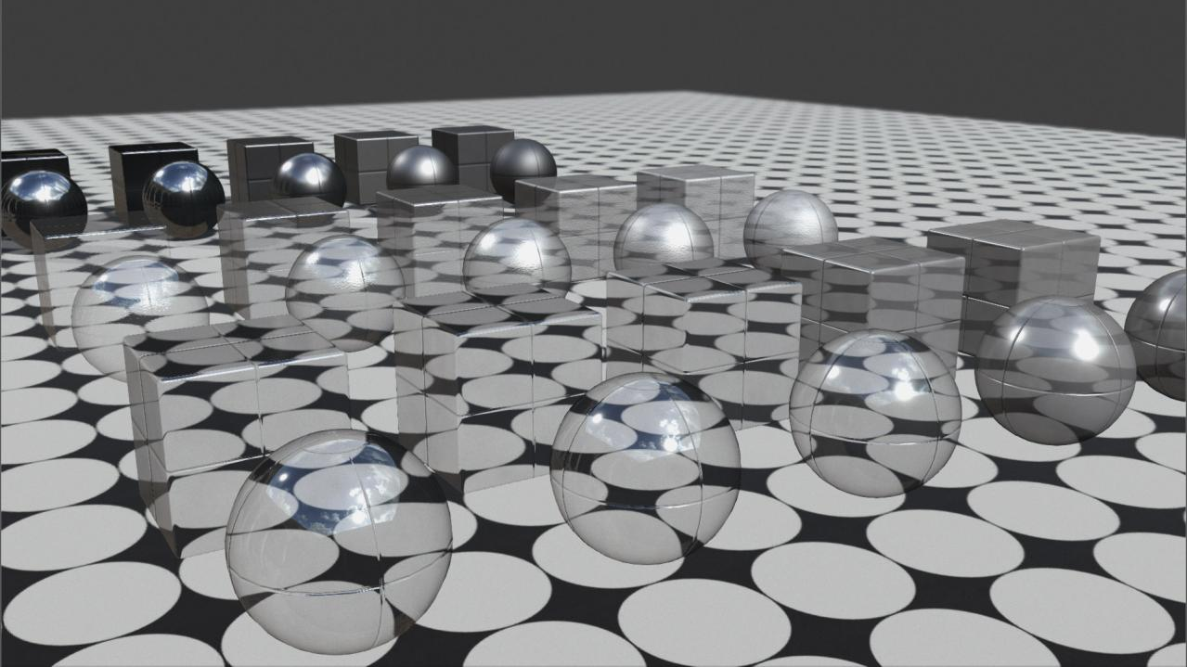
Material Template Samples
Glass
Notes:
And glass

Slide 19
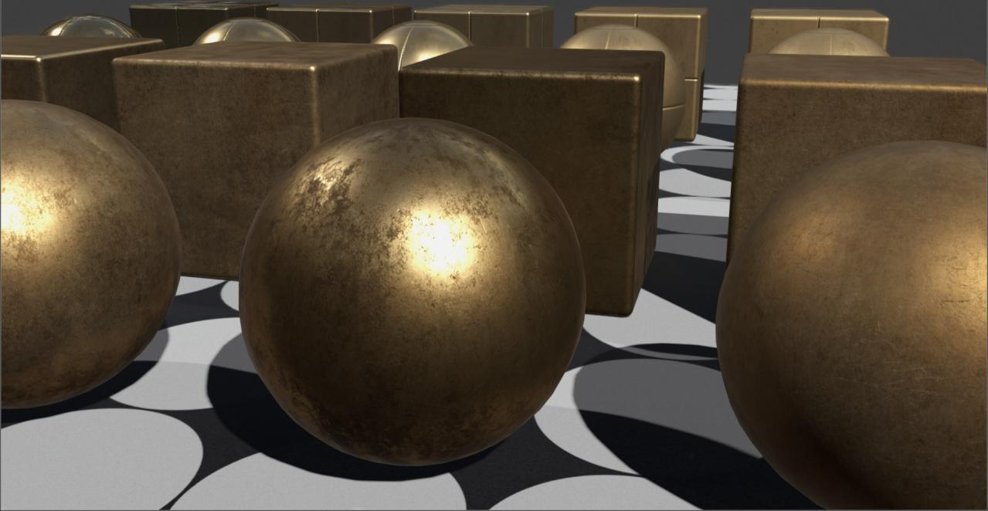
Common Materials
Notes:
So this then leads us to our common material library, which is the first stage where artistic variation is introduced

Slide 20
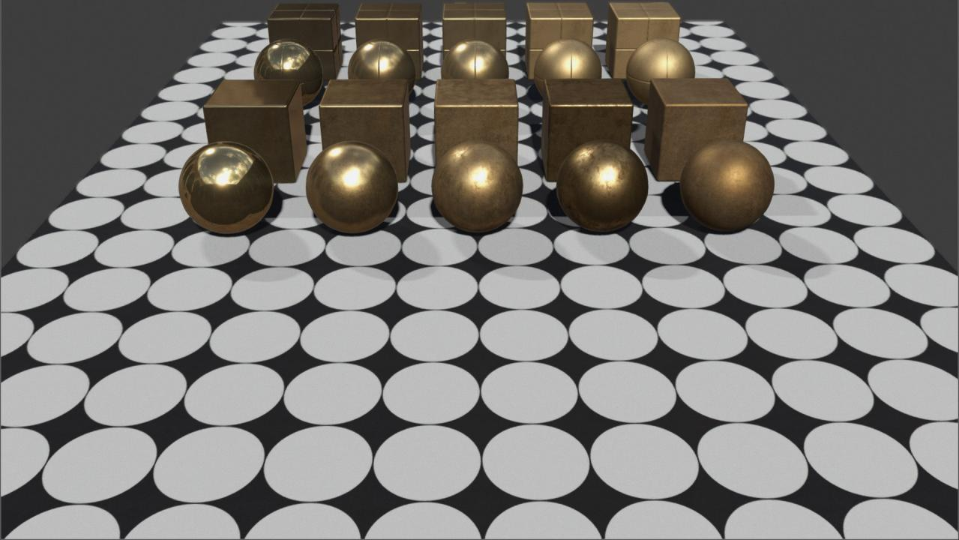
Common Materials
Brass Templates
Brass Commons
Common Material Guidelines
Authored by the environment texture team
All shading response from templates
Still not used directly in game!
Notes:
So moving down the chain in our overall material hierarchy, the templates I just described inherit directly down to what we call our common materials [CLICK]
These common materials are the responsibility of the environment texture team [CLICK]
All shading response in each pixel of a common material comes from the templates. The inherited shading parameters are never unlocked. [CLICK]
Common materials are still not used directly in game.
Even if a particular environment could use a certain common material, as is, the artist would still inherit to a level version.
This is helped us audit memory and material usage. It also allowed the texture artist to tweak the level version to suit their purposes, without disrupting other people that might be branching off from the same common.

Slide 21
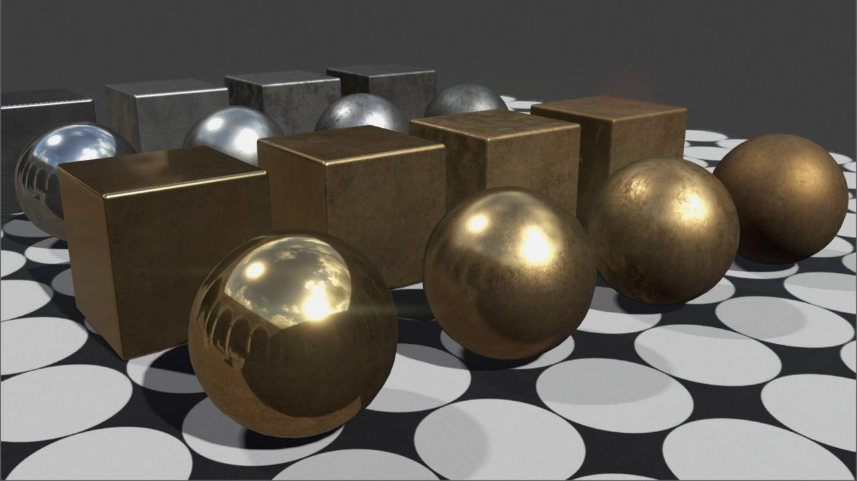
Common Material Samples (Surface Studies)
Metal
Notes:
Here are some quick examples of common materials. First a few simpler ones such as metals

Slide 22
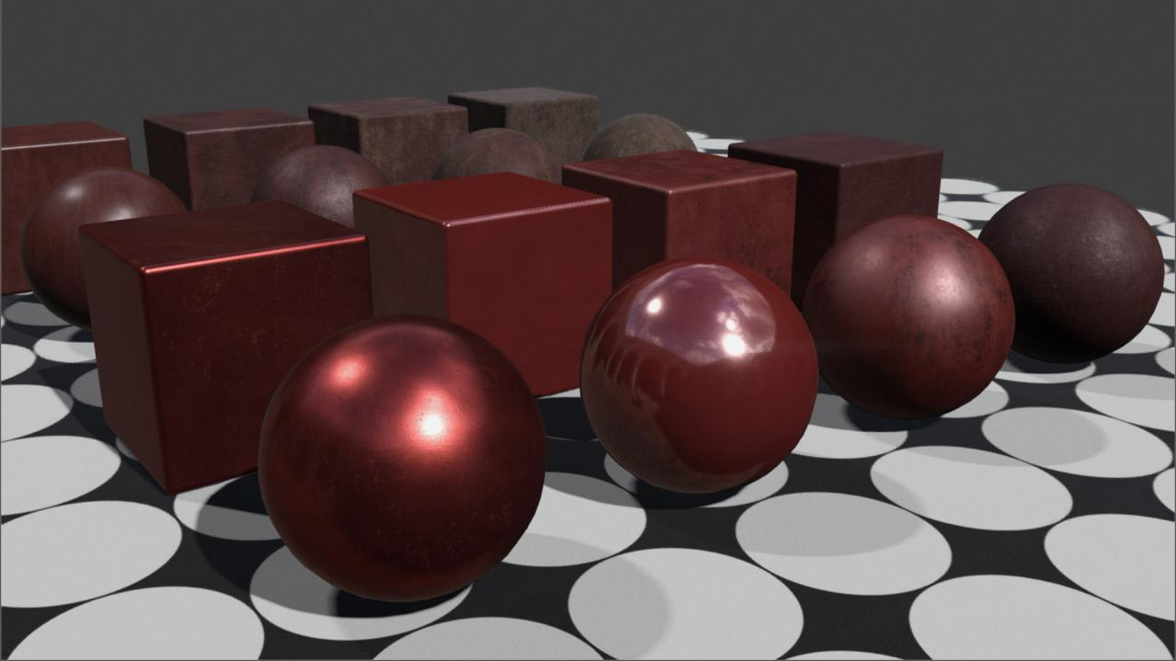
Common Material Samples (Surface Studies)
Paint
Notes:
And various paint coatings, from shiny metallic, to lacquers, enamel, oil, etc, including various stages of wear

Slide 23
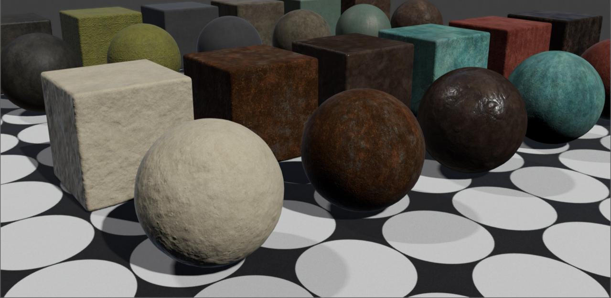
Common Material Samples (Surface Studies)
Aged
Notes:
This is a sample of our aged common categories. These include tiles of various weathering ingredients such as dust, dirt, mud, rust, oxidation, and tarnish. They come in many more types and color variants than pictured here.

Slide 24
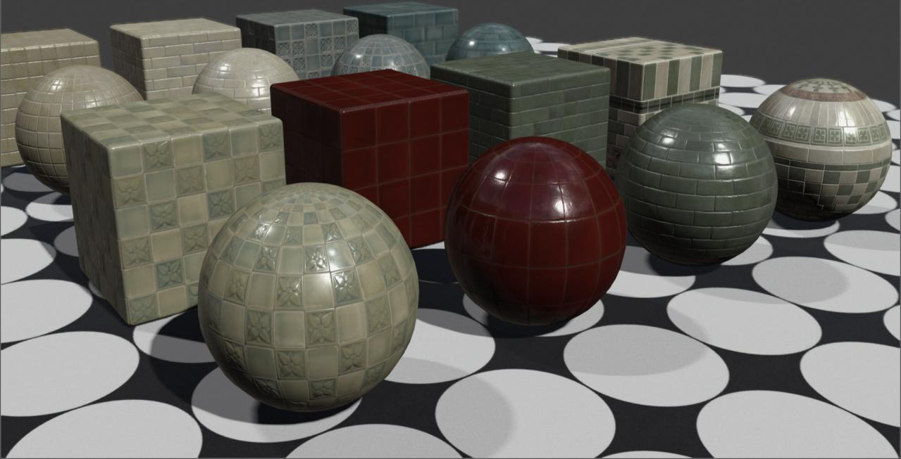
Common Material Samples (Sculpted Patterns)
Ceramic
Notes:
The next two examples show sculpted pattern common examples. Such as ceramic tiles pictured here.

Slide 25
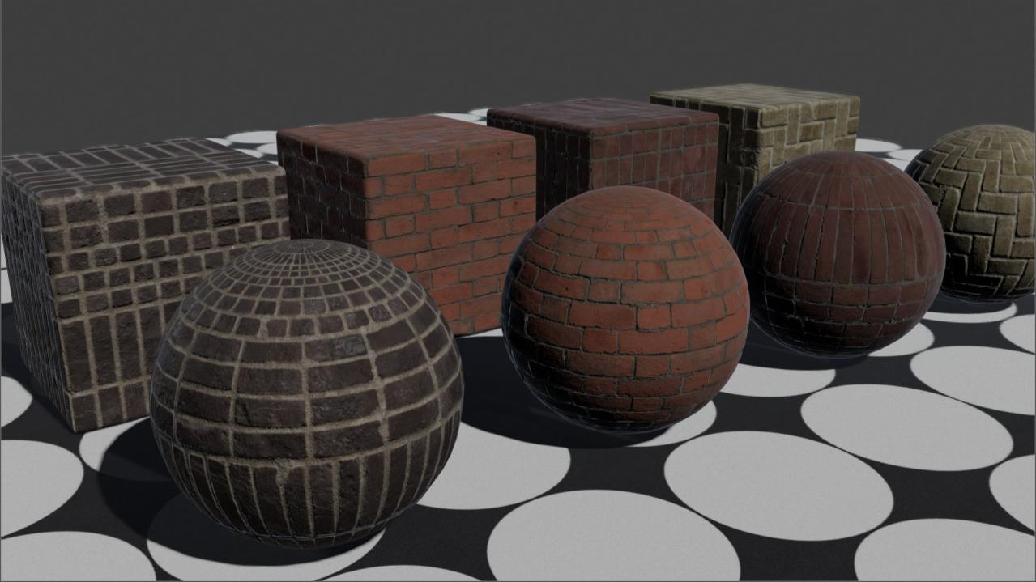
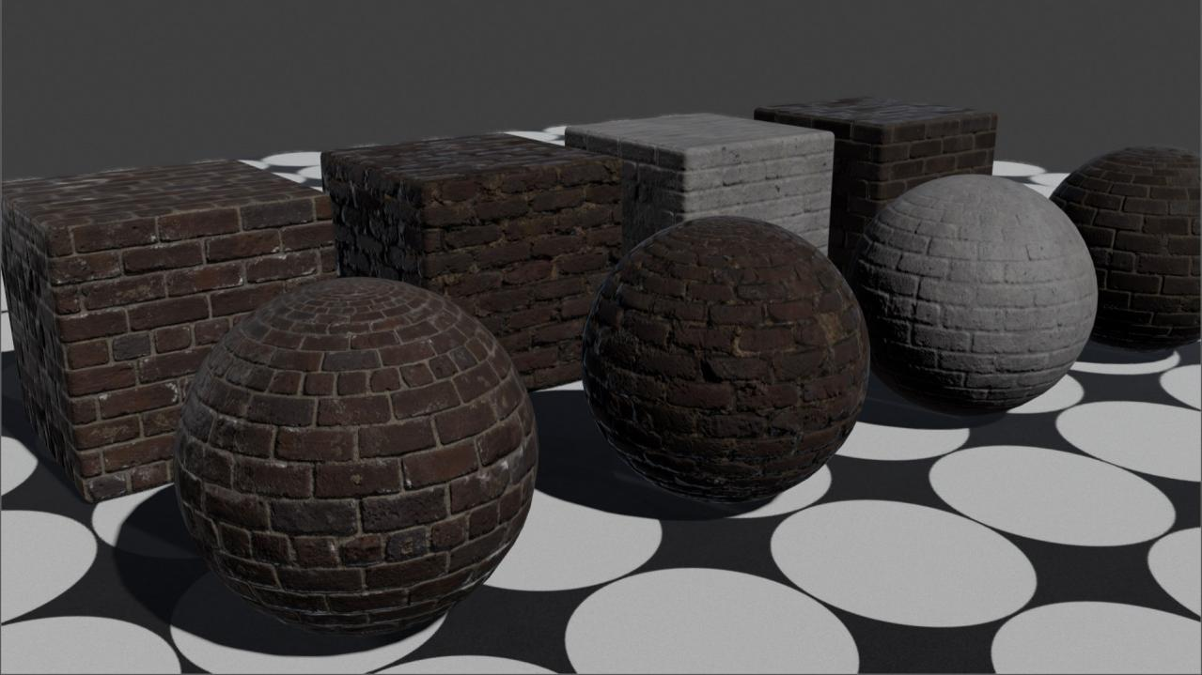
Common Material Samples (Sculpted Patterns)
Brick (Pattern)
Notes:
And the bricks here. The bricks are a nice example as well, as they show how we separate components in our material studies.
[CLICK]
Here are a few more pure brick patterns.

Slide 26
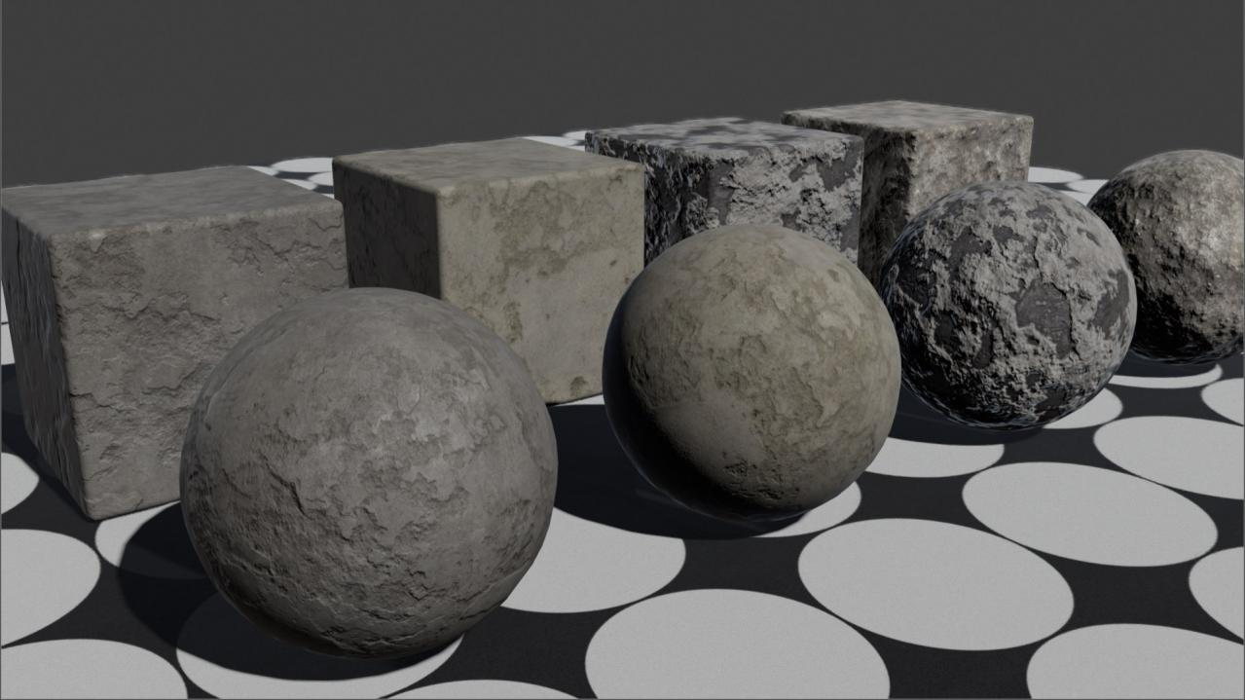
Common Material Samples (Sculpted Patterns)
Brick (Mortar)
Notes:
And here are pure studies of mortar

Slide 27
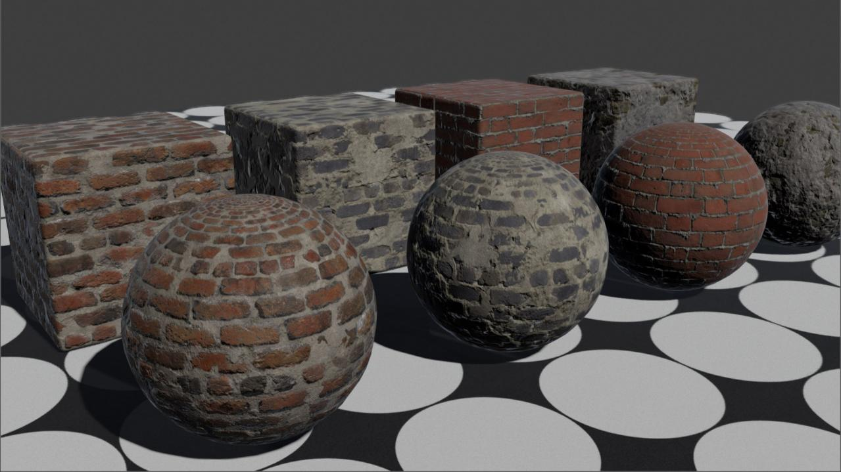
Common Material Samples (Sculpted Patterns)
Mix
Notes:
Either ingredient can be used in on it’s own, but even better, can then be mixed together without making a unique material from scratch.

Slide 28
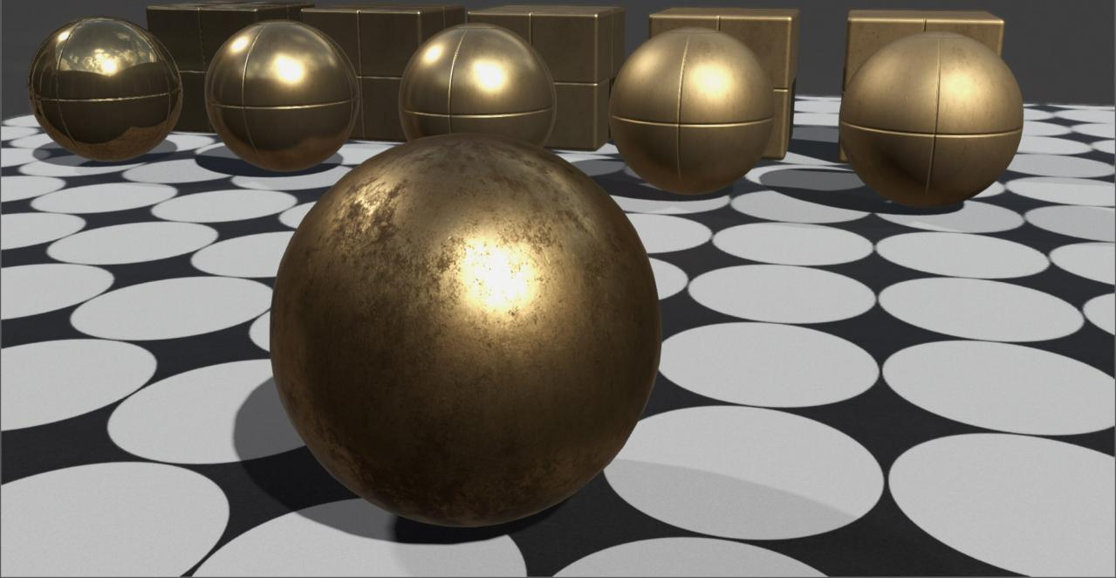
Material Compositing
How do we link each pixel of a common to a template?
Notes:
Alright, so how do we link these pure templates to each pixel in a common?

Slide 29
Material Compositing
Material Compositing
Defines shading response per-pixel by any material
End result smashed down by material build process
Notes:
This done through our system of material compositing.
Think of it as a photoshop layer system for materials. Each layer supports a linked alpha mask, but instead of just a single 2d texture like photoshop, each layer composites full shading properties. Artists can control tiling, opacity, blending modes, as well as per channel shading contribution, such as spec, diffuse, or normal intensity.
This might sound expensive, but it’s not. Our material build system smashes down all of these layers to a single layer internal texture whenever it’s saved or built. These textures under the hood are more efficiently packed than if an artist had manually authored each shading map on their own.
So, if you have a 100 composite layers, totally fine. The end result will still be a flat material in whatever output resolution size you set

Slide 30
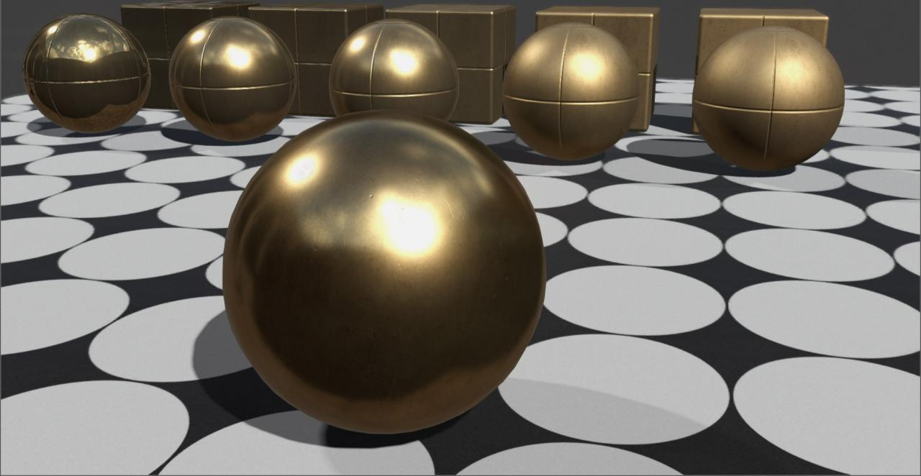
Material Compositing
Compositing Removed
Compositing Active
Notes:
To quickly run through an example of compositing and one of our brass common materials, here is the resultant material.
And here it is with the compositing disabled

Slide 31
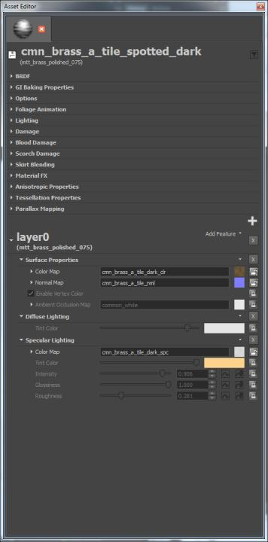
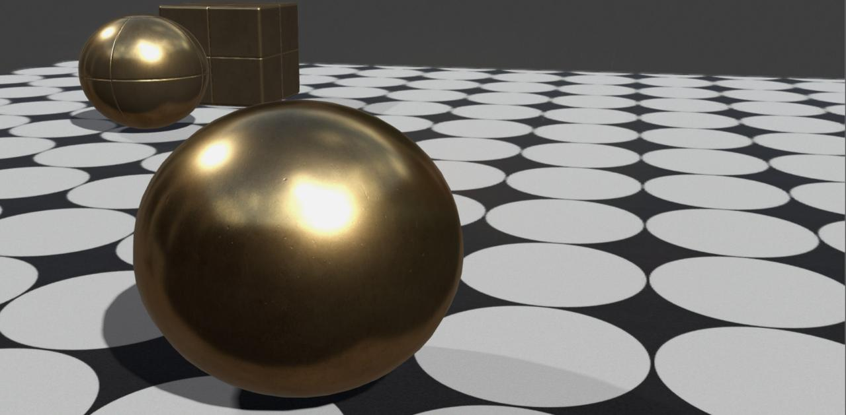
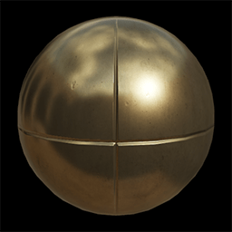
Material Compositing
mtt_brass_polished_075
Base Derived Template
Notes:
Here the base shading response comes through material inheritance. You can see that the material has it’s base set to one of the brass templates

Slide 32
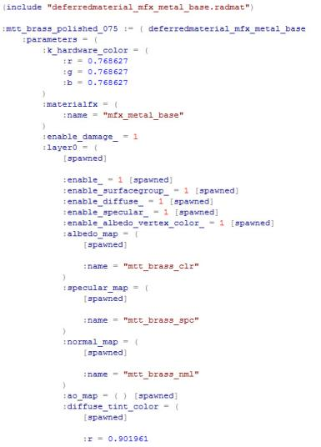

Material Compositing
mtt_brass_polished_075
cmn_brass_a_tile_spotted_dark
Base Derived Template
Notes:
Here are the material definitions, just to show there is virtually no data in the common material file. There are only 3 overrides from the template, to unlock the basic texture map slots to switch those out. Everything else passes cleanly from the template.

Slide 33
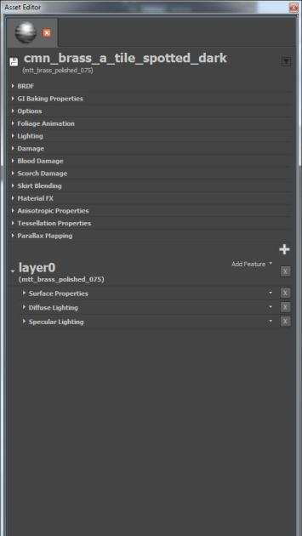
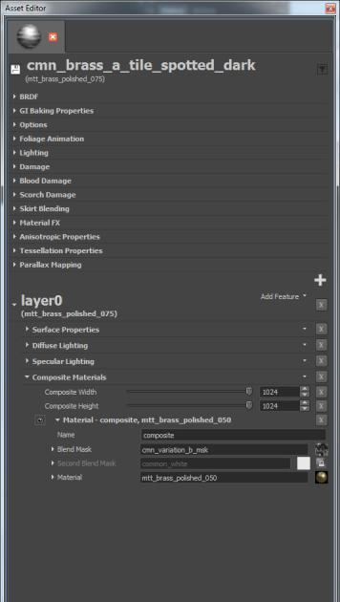
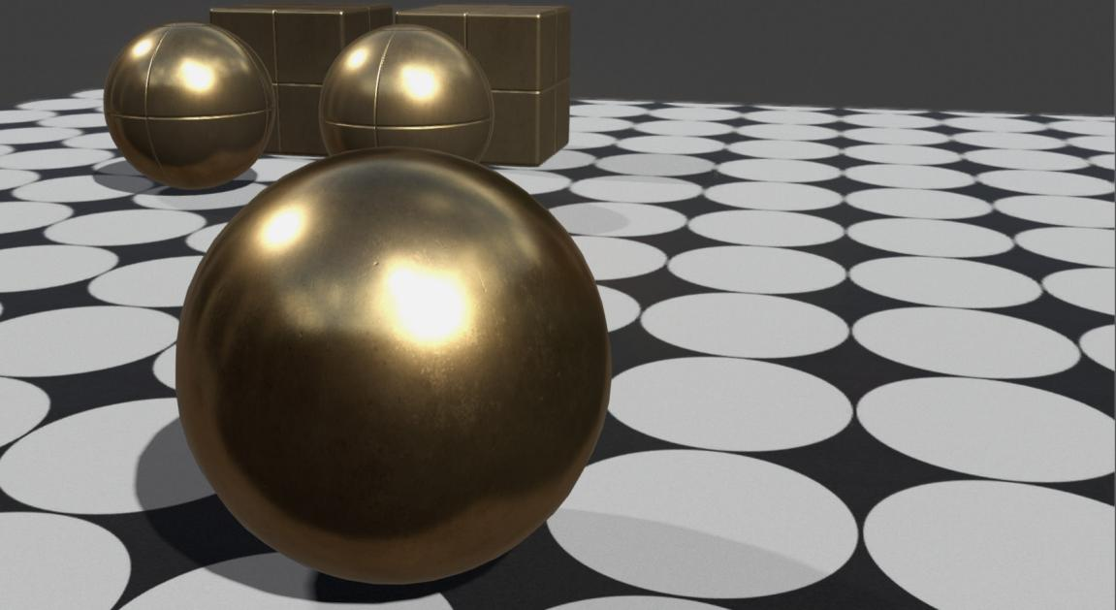
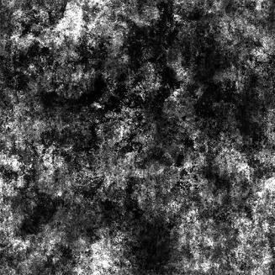
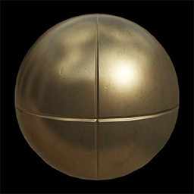
Material Compositing
mtt_brass_polished_050
generic variation mask
Composite Layer 1
Base Derived Template
Notes:
Now I’ll show the results of adding the compositing feature and inserting a base layer.[CLICK]
A more worn brass template is dropped into the first composite layer[CLICK]
And then linked to a generic variation mask to add subtle shading breakup

Slide 34
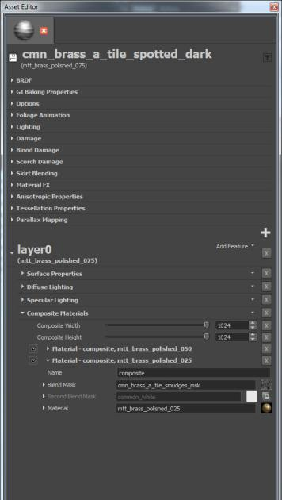
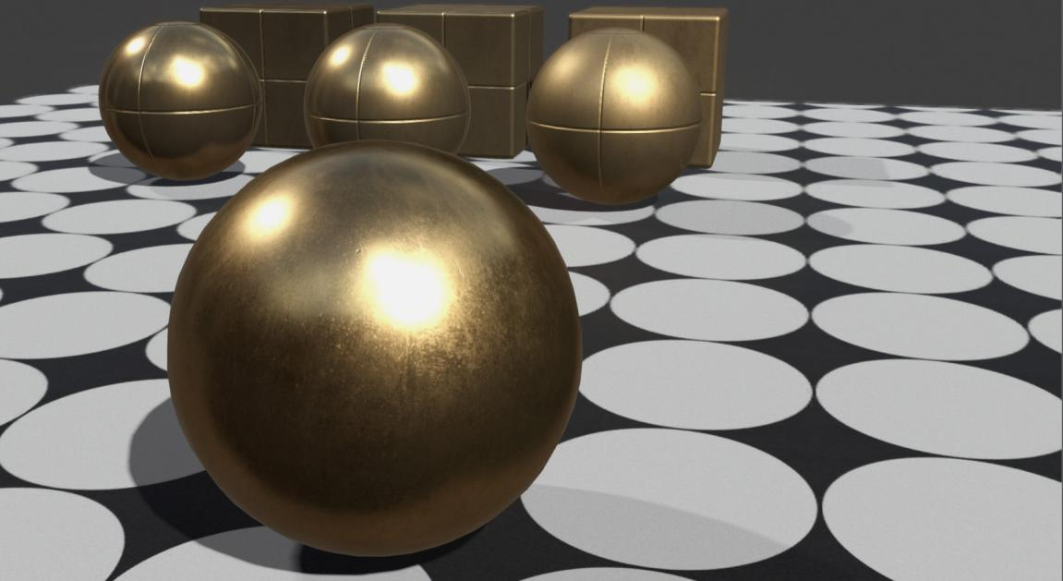
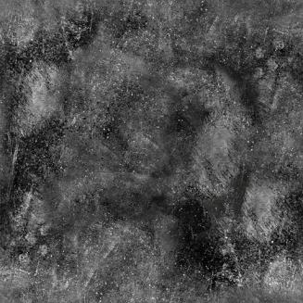
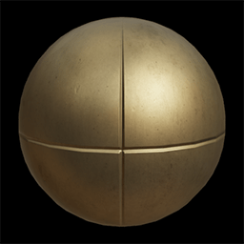
Material Compositing
mtt_brass_polished_025
smudges mask
Composite Layer 2
Notes:
And here’s another more worn brass template added with a different mask

Slide 35
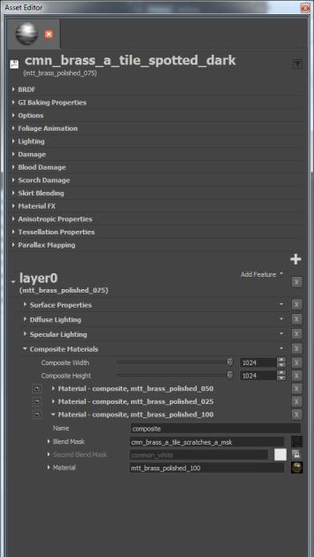
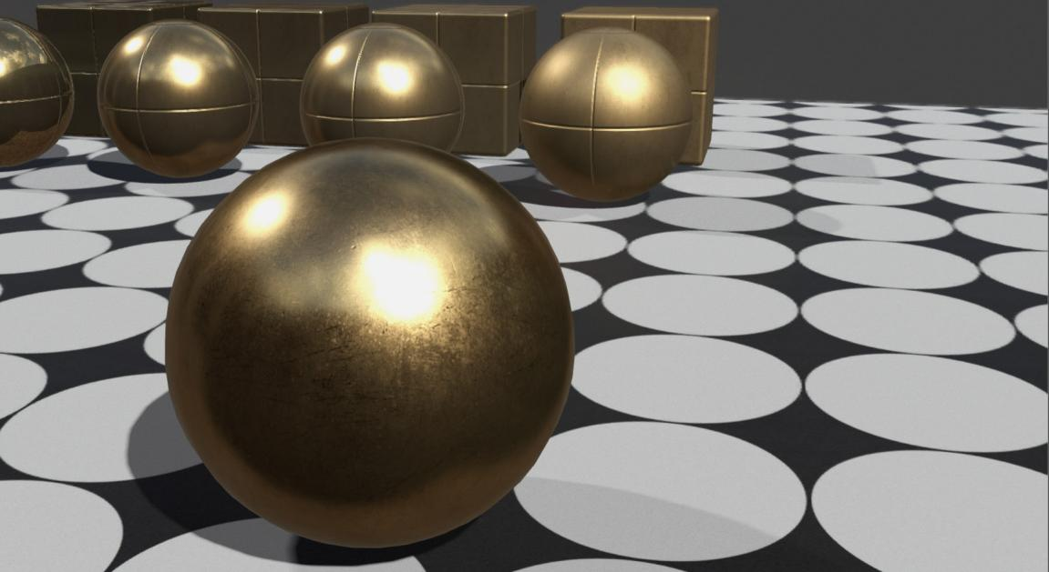
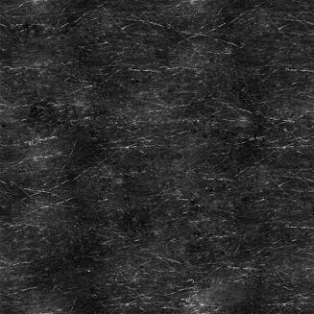
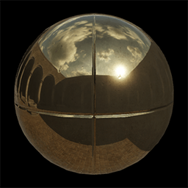
Material Compositing
mtt_brass_polished_100
scratches mask
Composite Layer 3
Notes:
And one more to indicate scratches revealing a pristine brass surface.

Slide 36
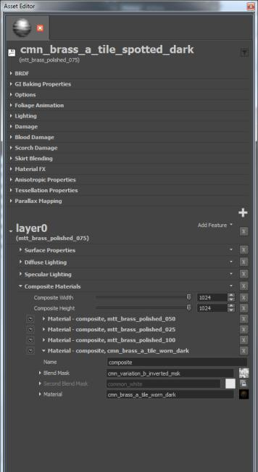
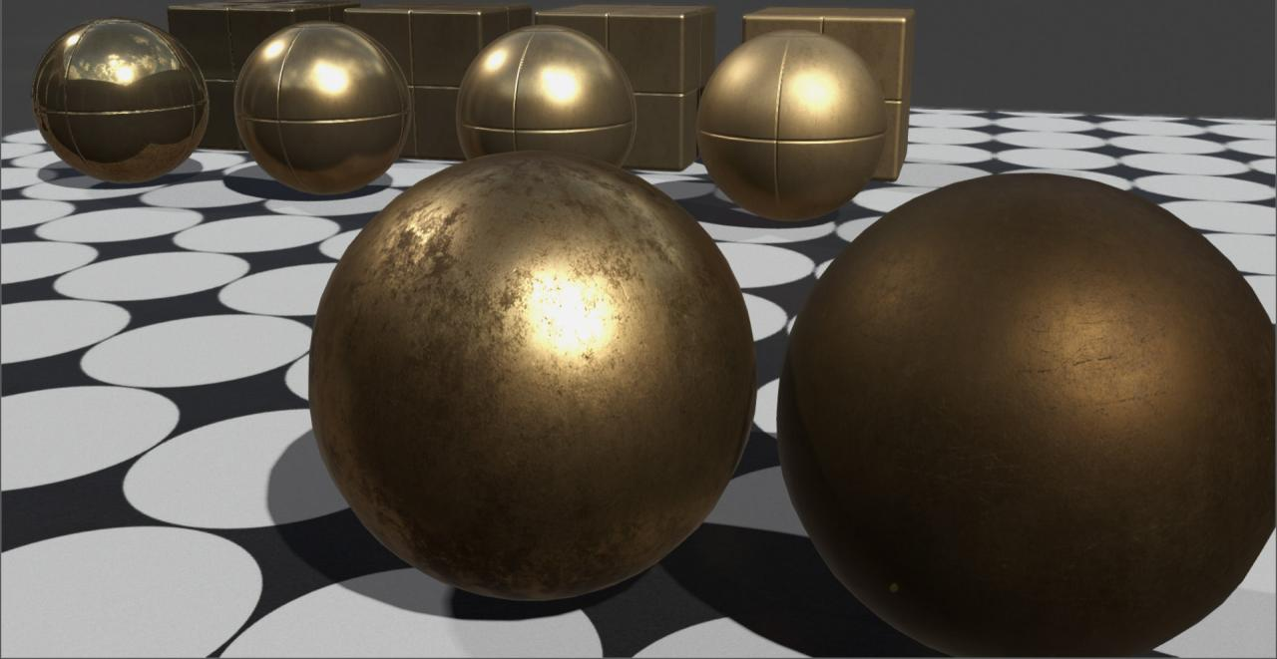
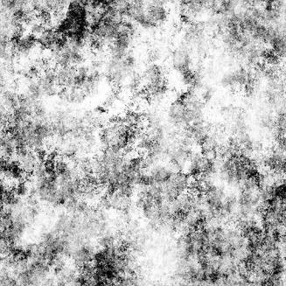

Material Compositing
mtt_brass_polished_100
cmn_brass_a_tile_worn_dark
generic mask
generic variation mask
Composite Layer 4
Notes:
This last step gets even more interesting, because now we are compositing another common. Unlike with the previous templates, this layer has textures enabled on the composite.
Not only do we get an alteration to the shading response, but also textures, including additive height data. You may notice the coarser normal map from the worn common brass material now eating into the surface of the cleaner metal where it is active

Slide 37
Material Compositing
Notes:
So here you can see a nice, artistic variation of a brass material that is quickly assembled from simple masks.

Slide 38
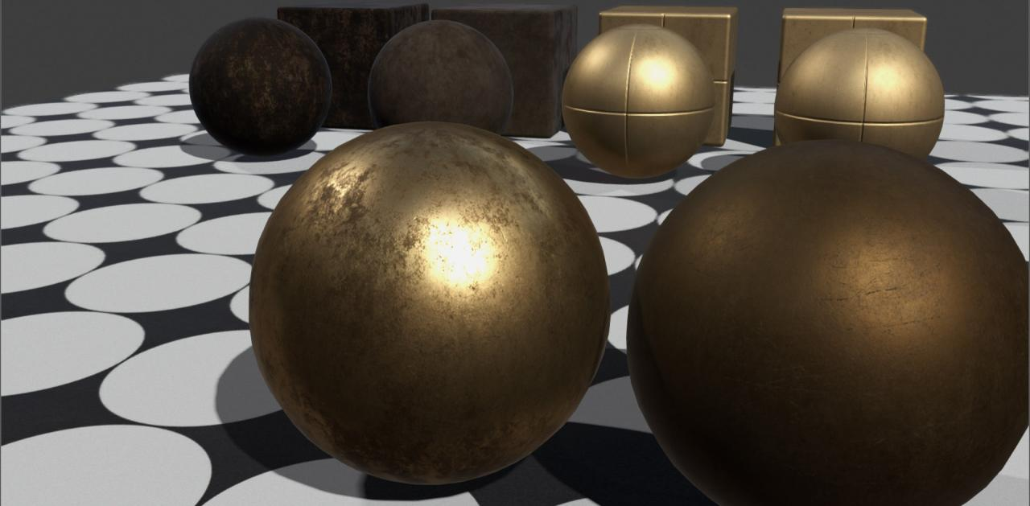
Material Compositing
Notes:
Including one of it’s own ingredients coming from another common material.
Itself in turn being derived from other templates and dirt common materials.

Slide 39
Material Pipeline Hierarchy
Brass Templates
Notes:
So going back to our material hierarchy overview, you can see how starting with the templates

Slide 40
Material Pipeline Hierarchy
Brass Templates
Brass Commons
Notes:
We can author a far larger database of artist commons

Slide 41
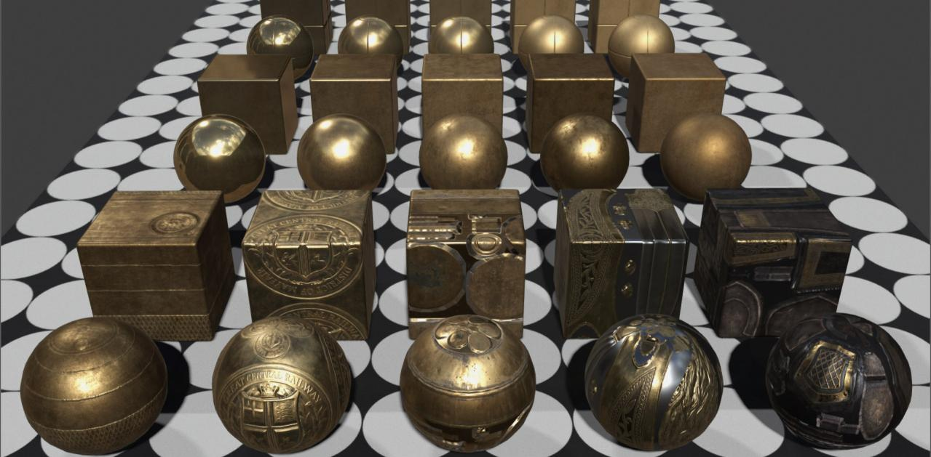
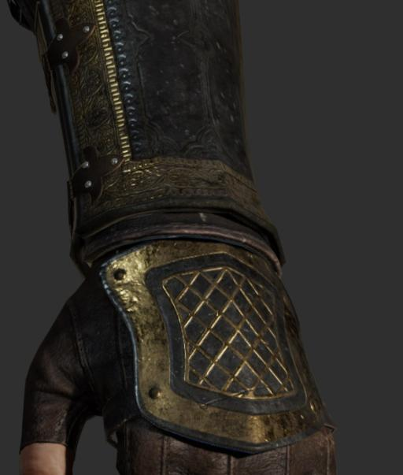
Material Pipeline Hierarchy
Brass Templates
Brass Commons
Production
Environment
Production
Props
Production
Characters
Notes:
Which then in turn are used to composite every single, environment tile, prop, and character material in the entire game.

Slide 42
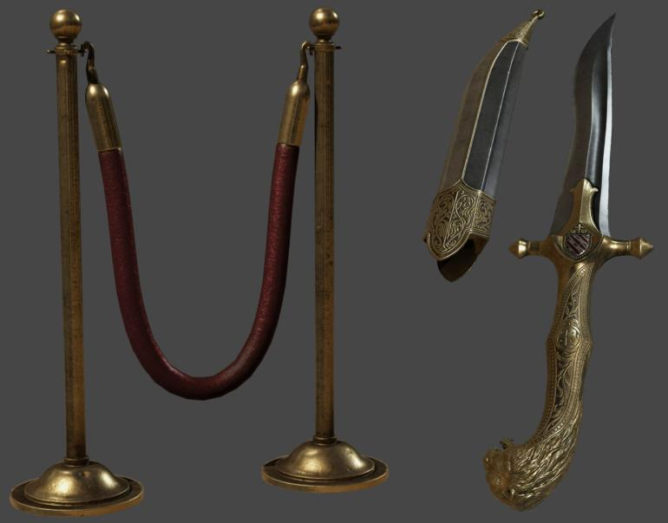
Material Pipeline Hierarchy
Notes:
Here are a sample of a few props and character costumes, surfaced by compositing commons, and by way of the commons back through the material templates

Slide 43
Material Pipeline Hierarchy
Advantages of compositing
High quality environment tiles help surface all assets
Shading look of entire game linked purely to templates
Notes:
This is incredibly powerful, as all of our environment texture team’s efforts in crafting really refined tiling materials actually helps surface the entire game.
And our inheritance chain all the way back to the small set of templates also remains unbroken. Even down to every material pixel in the game.
Say we found we needed to rebalance the brass templates a little bit, changes to five simple materials would automatically pipe through to each brass derived pixel in this stanchion, blade hilt and bracer material.

Slide 44
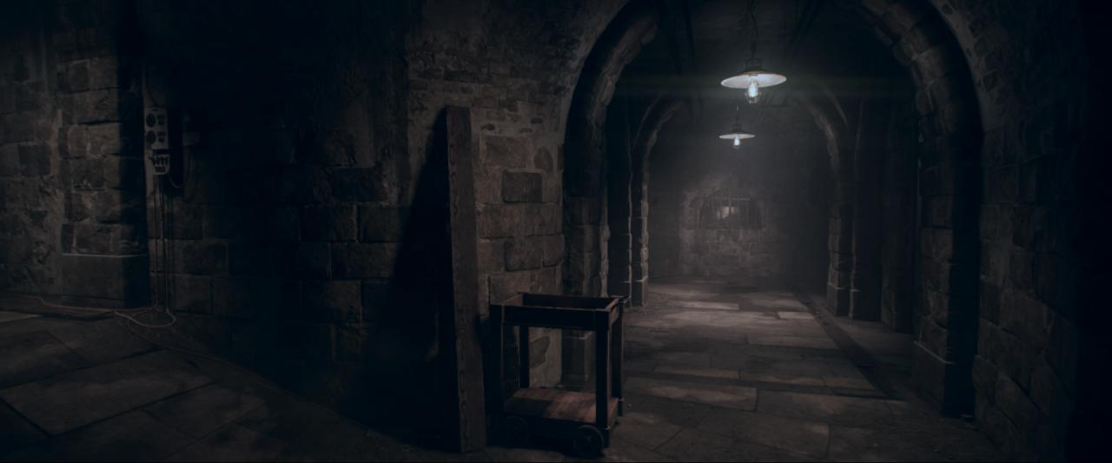
Environment Modeling and Materials
Notes:
Hopefully this gives people a quick overview of our general material system, and now I’m going to pass things over to Tony to go into more depth on some specific environment art pipelines and techniques.

Slide 45
Environment Modeling and Materials
Don't reinvent the wheel
Tiling textures
Layered materials
Skirt / Decal meshes
Strong modeling
Keep one-off baked assets to a minimum
Notes:
When looking at our environment pipeline our goals were to have:
--Consistent high quality assets
--Fast iteration
--Minimize our memory footprint
We didn’t try to reinvent the wheel.
We took what worked for us in the past and built on top of that.
--Tiling textures
--Layered materials
--Skirt / Decal meshes
--Strong modeling
--Keeping one-off assets to a minimum. [CLICK]

Slide 46
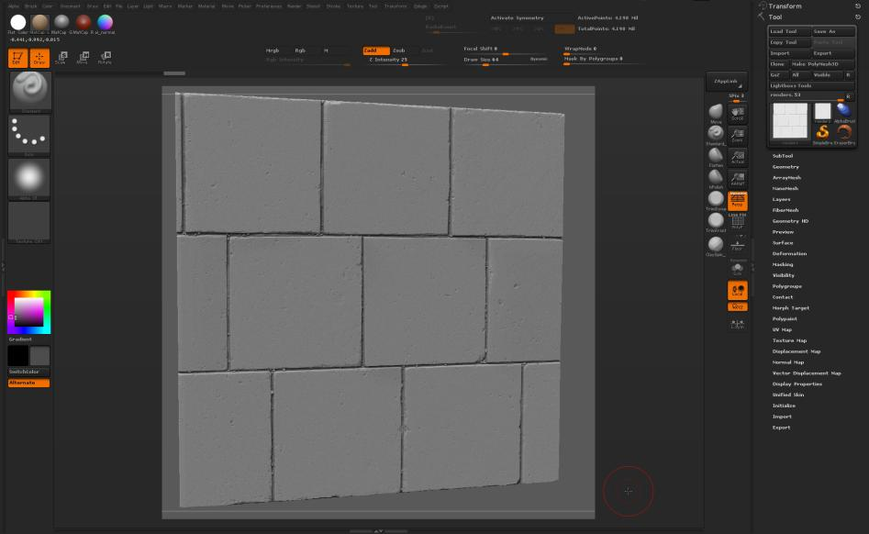
Material Compositing
Zbrush sculpt
Notes:
Starting with material compositing.
The majority of our tiling textures are sculpted in Zbrush.
Normal and height maps are the most important for us and we get the best result from Zbrush. [CLICK]

Slide 47
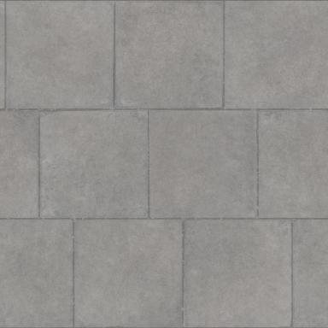
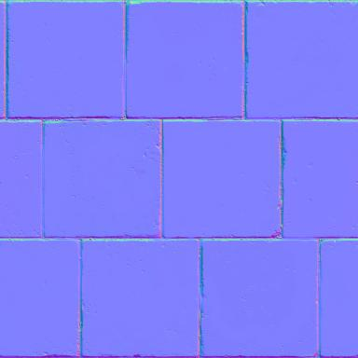
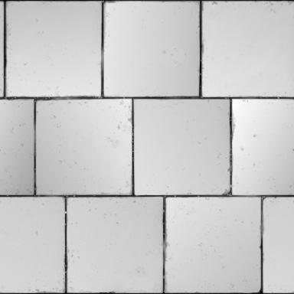
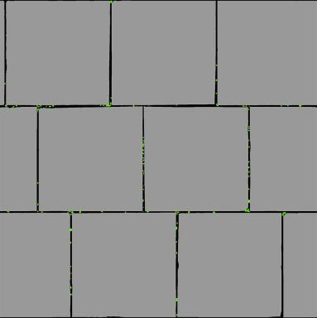
Material Compositing
Color
Normal
Height
Id
Texture maps exported from Zbrush
Notes:
From Zbrush we export our
--color
--normal
--height
--and id maps. [CLICK]

Slide 48




Material Compositing
Occlusion
Mask: Moss
Mask: Wear
Mask: Grout
Composite masks and occlusion
Notes:
From those maps we create our
--occlusion
--and composite masks. [CLICK]

Slide 49


Material Compositing
mtt_concrete_polished_050
Base template:
Notes:
Here I have the color, normal and occlusion maps load [CLICK] with a single material template. [CLICK]

Slide 50


Material Compositing
mat: cmn_granite_a_tile_grey_light
mask: cmn_concrete_sidewalk_a_stone_msk
Surface Detail: Composite additive material normal and occlusion only
Notes:
With this composite layer I’m adding surface detail. [CLICK]
Only the normal and occlusion maps are being composited. [CLICK]

Slide 51


Material Compositing
mat: cmn_dirt_fine_a_tile_brown_dark
mask: cmn_variation_b_inverted_msk
Surface dirt: Composite full material
Notes:
Adding surface dirt. [CLICK]

Slide 52


Material Compositing
mat: mtt_quartz_polished_100
mask: cmn_flakes_a_light_msk
Flakes of quartz: Composite shading properties only
Notes:
Adding flakes for quartz. [CLICK]

Slide 53


Material Compositing
mat: cmn_water_dampness_000
mask: cmn_variation_b_msk
Dampness: Composite full material
Notes:
Adding dampness. [CLICK]

Slide 54


Material Compositing
mat: mtt_concrete_polished_000
mask: cmn_concrete_sidewalk_a_var_msk
Surface wear: Composite shading properties only
Notes:
Adding worn areas of the stones. [CLICK]

Slide 55


Material Compositing
mat: cmn_terrain_dirt_fine_a_tile
mask: cmn_concrete_sidewalk_a_grout_msk
Grout dirt: Composite full material
Notes:
Adding dirt between the stones. [CLICK]

Slide 56


Material Compositing
mat: cmn_moss_fine_a_tile_mix_a_green
mask: cmn_concrete_sidewalk_a_moss_msk
Moss: Composite full material
Notes:
Adding moss between the stones. [CLICK]

Slide 57

Environment Material Compositing
Notes:
Here is the final composited tiling material. [CLICK]

Slide 58
Material Compositing
The majority of common and environment materials are 1024 x 1024
A composited material is packed into four texture maps
Color w/ alpha
Normal
Specular
Component
Height, Emissive, Backlighting and Detail Normal maps are not packed with compositing
Notes:
The majority of common and environment materials are 1024 x 1024.
A composited material is packed into four texture maps.
Height, emissive, backlighting and detail normal maps are not packed with compositing.
We don’t pack those maps because we share and swap them between different materials. [CLICK]

Slide 59

Run-time Material Layer Blending
Notes:
Now we take our composited tiling materials and use them in layer blend materials.
Most of our environment layered materials have between two to four layers.
This gives us the ability to use tiling materials to achieve an incredible amount of variety in our environments. [CLICK]

Slide 60

Run-time Material Layer Blending
Base layer_Stone floor:
Notes:
As an example, Starting with Base Layer of Stone Floor [CLICK]

Slide 61



Run-time Material Layer Blending
Layer #2_Sand: Basic height blend
Notes:
Second layer
Sand
Basic height blend. [CLICK]

Slide 62


Run-time Material Layer Blending
Layer #3_Damp: Combine normals off
Notes:
Third layer
Dampness
But in this case I don’t want to overwrite the underlying layer [CLICK]
I want to combine with it.

Slide 63


Run-time Material Layer Blending
Layer #3_Damp: Combine normals on
Notes:
I want to combine with it. [CLICK]

Slide 64


Run-time Material Layer Blending
Layer #3_Dampness: Diffuse Albedo alpha
Notes:
With our blending controls I tune the Diffuse Albedo contribution of the dampness layer.
This is starting to look better but, the dampness needs to mix with the underlying materials [CLICK]

Slide 65


Run-time Material Layer Blending
Layer #3_Damp: Specular Albedo & Roughness alpha
Notes:
With our blending controls I tune the Specular Albedo and Roughness contribution of the dampness layer.
Now I have a more realistic mixing of the materials.
The sand looks like it has absorbed more water than the stone
Our blending controls also have allowed us to save on texture memory.
We can use a single dirt and grunge layer and blend it to look unique for each use. [CLICK]

Slide 66


Run-time Material Layer Blending
Layer #4_Water: Basic height blend
Notes:
Fourth layer :
Water puddles
Basic height blend. [CLICK]

Slide 67

Run-time Material Layer Blending
Add modeled floor stones
Notes:
To push this floor further I’m adding modeled floor stones. [CLICK]

Slide 68

Run-time Material Layer Blending
Add modeled rocks and pebbles
Notes:
Adding modeled rocks and pebbles. [CLICK]

Slide 69

Run-time Material Layer Blending
Add skirt mesh for trash
Notes:
Adding a skirt mesh for trash and debris. [CLICK]

Slide 70

Runtime Material Layer Blending
Notes:
Here is the final result.
Showing this is all run-time. [CLICK]

Slide 71

Skirts
Notes:
Skirts are meshes that we float over opaque geometry.
We would use skirts for things like:
--graffiti and posters on a walls
--or piles of leaves on the ground. [CLICK]

Slide 72


Skirts
Skirt materials use texture alpha
and vertex alpha
Notes:
They can use texture alpha [CLICK] and vertex alpha. [CLICK]

Slide 73

Skirts
Skirt materials can combine with underlying normal maps
Notes:
They also can combine with underlying normal maps. [CLICK]

Slide 74


Skirts
We use skirts a lot for our ground surfaces
Notes:
We use skirts a lot for our ground surfaces. [CLICK]
To smooth the transition between wall to ground. [CLICK]

Slide 75
Skirts
Render over opaque materials only
A little more costly than an opaque, but cheaper than a transparent
A layered material can also be a skirt
Notes:
They render over opaque materials only.
They are a little more costly than an opaque, but cheaper than a transparent.
And a layered materials can also be a skirt. [CLICK]

Slide 76

Environment Modeling
Notes:
Now that we had high quality materials we needed to push our modeling further. [CLICK]

Slide 77


Environment Modeling
Single edge with split vertex normals did not hold up close to the camera
Notes:
We found that a single edge with split vertex normals did not hold up. [CLICK]
They looked harsh and unrealistic compared to our material quality. [CLICK]

Slide 78


Environment Modeling
Two edge bevels with custom set vertex normals
Notes:
We moved to two edge bevels [CLICK]
with custom set vertex normals. [CLICK]

Slide 79




Environment Modeling
.001953125
1/512 of a meter
0.00390625
1/256 of a meter
0.0078125
1/128 of a meter
0.015625
1/64 of a meter
Bevel presets and guidelines
Notes:
We put bevel presets and guidelines put in place. [CLICK]
So that we had consistency trough out the game. [CLICK]

Slide 80




Environment Modeling
.001953125
1/512 of a meter
0.00390625
1/256 of a meter
0.0078125
1/128 of a meter
0.015625
1/64 of a meter
Bevel presets and guidelines
Notes:
So that we had consistency trough out the game. [CLICK]

Slide 81




Environment Modeling
In-game model without normal maps
Notes:
Here are some samples of our in-game models without any normal maps. [CLICK]
A boiler from the whitechapel underground. [CLICK]

Slide 82




Environment Modeling
In-game model without normal maps
Notes:
Engine from airship. [CLICK]

Slide 83


Environment Modeling
In-game model without normal maps
Notes:
We also used this approach for organics. [CLICK]
Rocks from blackwall yards. [CLICK]

Slide 84
Edge Beveling
Advantages of two edge beveling
Higher quality models without excessive poly count
Reduced number of one-off baked assets
Disadvantages
Had to create custom vertex normal tools
Most normals have to be set by artists
Increased the amount of sub-pixel triangles
Notes:
Advantages of two edge beveling:
--Higher quality models without excessive poly count
--Reduced the number of one-off baked assets.
Disadvantages:
--Had to create custom vertex normal tools
--Most normals have to be set by artists
--Increased the amount of sub-pixel triangles
[CLICK]

Slide 85

Environment Modeling and Materials
Notes:
So we have covered:
--Material Compositing
--Layer blending
--Skirts
--Modeling
So now we are going all those pieces together. [CLICK]

Slide 86


Environment Modeling and Materials
In-game model without normal maps
Notes:
In-game model without normal maps. [CLICK]

Slide 87


Environment Modeling and Materials
Base layer: Varnished wood light
Notes:
Layered Material:
Varnished wood base layer. [CLICK]

Slide 88


Environment Modeling and Materials
Layer #2: Varnished wood dark
Notes:
Second layer
Varnished wood dark
[CLICK]

Slide 89


Environment Modeling and Materials
Layer #3: Dust and grunge
Notes:
Third layer
Dust and grunge
[CLICK]

Slide 90



Environment Modeling and Materials
Add skirts and accessory set
Notes:
Now we add skirts and accessory set. [CLICK]
The accessory is the only one-off baked asset. [CLICK]

Slide 91

Environment Modeling and Materials
Notes:
Here is some of the furniture that we made for whitechapel hospital.
5-Tileable materials
2-Skirt materials
1-One-off baked material for the accessories.
These materials were also used on other assets through out the level.
Saved us a lot of memory!

Slide 92
Environment Modeling and Materials
In-game model without normal maps
Notes:
We took the same approach for organics.
In-game model without normal maps. [CLICK]

Slide 93

Environment Modeling and Materials
Base layer: Rock rough
Notes:
Layered Material:
Base layer
Rock rough
[CLICK]

Slide 94

Environment Modeling and Materials
Layer #2: Rock smooth
Notes:
Second layer
Rock smooth
[CLICK]

Slide 95

Environment Modeling and Materials
Layer #3: Rock crumble
Notes:
Third layer
Rock crumble
[CLICK]

Slide 96

Environment Modeling and Materials
Layer #4: Water drips
Notes:
Fourth layer
Water drips
[CLICK]

Slide 97

Environment Modeling and Materials
Notes:
Rock set.
Uses 4-Tileable materials. [CLICK]

Slide 98


Tiling Materials and Baked Assets
Baked assets
Notes:
To finish I have some breakdowns to our show tiling textures to baked assets ratio. [CLICK]

Slide 99


Tiling Materials and Baked Assets
Baked assets
Baked w/ tiling
Notes:
Tesla’s lab is also a great example of our common library. [CLICK]
Only two new materials were made for this level.
All the other materials are from our common library. [CLICK]

Slide 100


Tiling Materials and Baked Assets
Baked assets
Notes:
Transition to Nate to talk about our lighting pipeline.

Slide 101

Lighting and Post Processing
Notes:
So to switch gears a bit, we’ve covered a lot of our art production processes that allowed us to achieve really consistent high quality assets, but all of this effort is wasted if our lighting and post processing doesn’t show it in the best light.

Slide 102

Post Processing
Post Processing Enabled
Notes:
I’m going to get post processing out of the way really quickly, mostly just to show how integral it is to our look, without any one feature necessarily jumping out to the player. Here you can see a scene in game from the roundtable room of Westminster Palace.

Slide 103

Post Processing
Post Processing Disabled
Notes:
And here it is with post processing disabled.

Slide 104
Post Processing Balance
Fullscreen FX Parameters
Tone Mapping
Exposure
Bloom
Fog
Air Density / Fog Blur
Screen Tint
Color Grading
Lens Flare
Lens Dirt
Lens Distortion
Depth of Field
Bokeh
Motion Blur
Chromatic Aberration
Film Grain
Vignette
Nothing revolutionary in any one ingredient
Notes:
Here’s a list of all of the full screen fx that are used to achieve this. I’m not going to go through each of these, as honestly there is nothing ground breaking in any one thing.

Slide 105
Lighting and Post Processing Balance
Fullscreen FX Usage
Cohesive mood achieved by sum of the parts
No effect used gratuitously
Light to simulate ‘natural world’
Strive for accurate light temperature, intensity, and scene exposure balance
Post processing then used for mood and style
Notes:
My point here is more about the usage of fullscreen fx and the image quality being more from the sum of the parts. Some things might jump out at you when I flip back and forth between those images, but hopefully to people playing the game, there isn’t any one thing that stands out as used gratuitously. [CLICK]
We also wanted to make sure that in our lighting process that we made a very clear distinction between what we considered lighting and post processing. Our general guidelines are that the underlying lighting in a scene is as physically informed by the natural world as possible, in terms of relative intensities and light temperature.
Further stylization of palette or mood should then be done through grading and post processing. This means no tinting lights of to make a scene cooler. Light it as if you were shooting on a physical location, and grade it as you would in post.

Slide 106
Lighting and Post Processing Balance
Balancing lighting and exposure
Set standard exposure targets
Time of day and weather conditions
Balance light intensities accordingly
Standardize HDR sky intensity ranges for conditions
Interiors with ranges of type of local illumination
Research and balance local light fixture types
Notes:
This leads us into balancing lighting and exposure.
This concept allowed us to share local lights and skies between scenes, and have consistent results between camera exposure, sky intensity, and particle effects, all properly balanced in HDR.
[CLICK]
To do this, we made a lot of effort in pre-production to set standards for exposure for various conditions, including time of day and weather.
[CLICK]
We would then balance a wide range of illumination types against this. This included setting ranges of HDR sky intensities as appropriate to each condition and testing interior lighting and various local light fixtures, with intensity scales relatively appropriate to each illumination type.

Slide 107

Lighting and Post Processing Balance
Sample mood variants through exposure and grading
Notes:
To show a quick example of exposure balance and grading in action, here’s our same round table scene from before. This version is from an earlier section of the game, during a day time council meeting of the knights.

Slide 108

Lighting and Post Processing Balance
Sample mood variants through exposure and grading
Notes:
And here is another shot from later in the game. Exact same lighting, but a quick grading adjustment paints a scene with a much more somber mood.

Slide 109

Lighting and Post Processing Balance
Sample mood variants through exposure and grading
Notes:
And here’s another one from an evening scene. Now the lighting looks quite different, but, the cool thing is… it really isn’t.
All that happened was the sky was swapped out to a night version, the sun key lights from the windows were turned off, and the exposure was brought up to our night time interior range.

Slide 110
Lighting and Post Processing Balance
Exact same local light instances
Higher exposure and lower intensity HDR skydome causes fixture illumination to look dramatically more pronounced at night
Sample mood variants through exposure and grading
Notes:
These fixture light rigs you see are the exact same ones from the day scenes, but with the higher camera exposure, and lower ambient light, suddenly their effect is perceptually more pronounced.
Not only did following these strict guidelines make for much more convincing scenes, working in a wide range of exposures, it also saved quite a bit of lighting time. As an example, after the initial round table room scene, I was able to make all three other variant round table scenes, for different acts of the game, in a single day, with little fuss.

Slide 111

Lighting and Post Processing Balance
Light fixtures defined globally
Instance database of fixtures
Pre-authored light rig templates
FX crafted for the fixture type
Balanced HDR light and particle intensities across all exposures
Notes:
As an example of out light fixture standardization, in the image here you can see the exact same incandescent light rigs, and their effect in various exposures. Besides standardizing lighting, this helped make sure that any light source FX, such as filaments and candles, were balanced in the same exposure range as the lights.
This concept also allowed us to share light fixtures among the entire lighting team. We piggy-backed off the environment team’s instancing pipeline to create a database for both physical light fixtures and any number of variant light rigs for them. These light rigs would then would snap automatically to the fixture instance at the a defined locator.
With this pipeline we were able to spend more time carefully balancing the illumination of each light type to be appropriate to our exposure scale and light temperature. It also let us put more time into handcrafting custom beauty lights in the rig to make the fixture look extra convincing.
Also, if we found performance issues with certain fixture rigs, as we could address the problem at a single source and propagate throughout any levels it was used in.

Slide 112



Lighting and Post Processing Balance
Sample Light Fixtures
Notes:
Here we have a few samples of light fixtures from the database. Lighting artists starting on a new environment could rummage through our instance ‘warehouse’ of available fixtures and spend more time working on broad strokes of tone, composition, and mood versus reinventing the wheel over and over.
What you see here is just a small subset of our generic light instances and rigs. We had much more than this in the database.
The running joke was that in the instance database we had over 100 unique light fixtures, and only 3 unique couches. The punchline is that it was not a joke.
Notice they are also prepackaged with balanced particle FX as well. We even had rainy exterior variants rigs that faked a higher density of rain and illumination of droplets near the light source, as well as water running down the globe of the fixture itself.

Slide 113

Lighting and Post Processing Balance
Notes:
This video shows and example of how we tested and balanced our exposure. We have this generic atrium environment that we populate with a range of lighting fixture types, and then make a sky rig for various times of day.
This video is from earlier in pre-production, so the emissive and HDR numbers don’t really match at all with the final game, but I think it paints the concept well of how we tested and established these guidelines.

Slide 114

Volumetric Lighting
Notes:
Now I’m going to talk briefly about our volumetric lighting features and techniques to apply them. For the sake of time I’m going to breeze through this section.

Slide 115
Volumetric Lighting
Thickness to air a key look to The Order: 1886
Interaction of punctual light sources
Atmospheric shape grading
Directs focus of gameplay and cinematography
Every scene in game uses this heavily
Upwards of 50 or more volumetric lights in scenes
Shadows, gobos, and high slice count used sparingly
Notes:
Given our setting of industrial revolution, Victorian London, we particularly wanted a visceral sense of thickness to the air to be a key look of our world
[CLICK]
This includes haze around local lights, but also general atmospherics and shape grading. Besides conveying strong sense of mood, but also was used as a compositional device to deliberately lead the players eye as appropriate to gameplay and storytelling.
[CLICK]
We used a ton of volumetrics in every single scene of that game, often in unexpected ways. We hate game linear fog, and try to replace it with volumetrics as much as possible.
We often had in excess of 50 or more volumetric lights, so we were careful to reserve the most expensive features, such as shadows and gobos, for a handful of lights that would make the biggest impact

Slide 116
Volumetric Lighting
Volumetrics Enabled
Notes:
For a comparison, here you can see our roundtable environment with volumetrics enabled

Slide 117

Volumetric Lighting
Volumetrics Disabled
Notes:
And now disabled. Notice there is almost no linear fog present in the scene, other than a really subtle background layer.

Slide 118

Volumetric Lighting
Notes:
I’ll just really quickly run through our basic volumetric feature types

Slide 119

Volumetric Lighting
Air Light
Simulates single bounce scattering of point light
Ties into air density property of fog
Very cheap
Notes:
Air lights were used at the center of local lights and simulated a single bounce scattering of a point light through a medium. In our case the medium is driven by the linear fog density times intensity of the point light itself.
These were very cheap, and we used them both as they were intended around local light sources, but also as general fog volumes, by hiding the intense emission point behind a wall or floor.

Slide 120

Volumetric Lighting
Light shaft
Low slice count
Used for both punctual and diffuse atmospherics
Notes:
And here are our spot lights with light shafts enabled. There is nothing too fancy about these, other than we optimized the hell out of them. Without shadows enabled, by the end of the project we were able to generally get away with just 3-4 slices for any of these.

Slide 121

Volumetric Lighting
Shadowing light shaft
Needs on average between 12-40 slices
Used sparingly
Notes:
And here’s the same spot light with light shaft shadows enabled. We would need a higher slice count on these to avoid ugly stepping, so these were a little more expensive and we’d have to be careful about their application.

Slide 122


Volumetric Lighting
Shadowing light shaft with gobo texture
Needs on average between 20-60 slices
Used very sparingly
Notes:
And finally here’s a spot light with shadows and a texture gobo enabled. These would need even higher slice counts, so we only used these when they really made a big impact to the player, such as on the lanterns used for gameplay.

Slide 123

Volumetric Lighting
Diffused spotlight with light shafts
Only 2 slices
Used to build more generalizaed atmospheric composition
Notes:
Here’s our same cheap spot light light shaft from earlier, but mucking with the spot light penumbra and near and far attenuation, we are able to diffuse the look to more of a blob primitive shape. This light only has 2 slices and is incredibly cheap.
We used light-shaft-only spot lights like this to sculpt general scene atmospheric compositions, without a really clear emission point.

Slide 124

Volumetric Lighting Samples
Volumetrics Disabled
Notes:
I’ll flip through a few sample scenes so you can see how crucial this feature was to our look.
Here you see a scene with volumetrics turned off.

Slide 125

Volumetric Lighting Samples
Volumetrics Enabled
Notes:
And here’s the actual scene from the game. Not only are light sources much more convincing, but also the overall image has a significantly better composition focus, and the haze gives the scene a much more convincing mood and presence.

Slide 126

Volumetric Lighting Samples
Volumetrics Disabled
Notes:
And here’s another example with volumetrics off.

Slide 127

Volumetric Lighting Samples
Volumetrics Enabled
Notes:
And on…
Not only is the scene more compelling, but it’s also much more readable, as the atmospherics layer and silhouette foreground and mid ground objects for better separation

Slide 128

Volumetric Lighting Samples
Volumetrics Disabled
Notes:
Here’s an even more dramatic example of the compositional silhouetting effect.

Slide 129

Volumetric Lighting Samples
Volumetrics Enabled

Slide 130

Volumetric Lighting Samples
Volumetrics Disabled
Notes:
Again notice there is almost no linear fog in our scenes

Slide 131

Volumetric Lighting Samples
Volumetrics Enabled
Notes:
The airlights here work great in conjunction with the pilot light flame FXto make them much more convincingly integrated into the scene. Our stupid tricks with diffuse light shafts and air lights hidden above the ceiling are used to sculpt the general haze

Slide 132

Volumetric Lighting Samples
Volumetrics Disabled
Notes:
And here’s one final example.

Slide 133

Volumetric Lighting Samples
Volumetrics Enabled
Notes:
Again notice how the volumetrics are very deliberately used to direct the viewers focus, and give a lot more depth to the scene.

Slide 134

Baked Lighting
Notes:
So I’ve talked a little bit about dynamic lighting features, but given our game needing to run locked at 30 FPS, the perceived look of our game would only be as good as its worst case conditions, which would include a large amount of static baked lighting, by necessity.
We had pushed so much on our material and specular model that we were determined to make sure that the quality of our material response wasn’t then lost in realistic production lighting.

Slide 135

Render Pass: Final
Notes:
Before getting into the specific features we implemented to achieve this, I’ll give a quick breakdown of a few of our render passes. Hopefully this helps give a sense of where the various components of lighting in this scene is coming from. The first thing you may notice is there is a lot of really subtle, but rich specular all over.

Slide 136

Render Pass: Dynamic Lights
Notes:
Which is particularly neat as this next image shows all of the dynamic lighting.
Almost nothing. Basically just the soft volumetrics and small localized lights around the candle fixtures. In fact the only reason the candles are dynamic lights are so they can have an animated flicker, as well as affect the SSS material on the wax.

Slide 137

Render Pass: Ambient Diffuse
Notes:
Here’s the ambient diffuse pass.

Slide 138

Render Pass: Ambient Specular
Notes:
And now the ambient specular. Most of the specular in this scene is actually baked.

Slide 139

Render Pass: Reflection Probes
Notes:
This pass shows our reflection probe sample points.

Slide 140

Render Pass: Reflection AO
Notes:
And finally our view dependent reflection AO, which is used as an occlusion pass for the probes.

Slide 141
Dynamic Lighting
Run-time Lights
Directional, Point, Spot
Run-time Occlusion Capsules
Calculated against rendering geo on the fly
Notes:
As an overview of where our various lighting comes from, for dynamic lighting we only support Directional, Point, and Spot light types.
We use a lot of dynamic lights and have a lot of great features to get high quality results out of them, but they are not particularly exciting, so I’m going to skip over them for the sake of time.
[CLICK]
We also have run-time occlusion capsules for shadowing into the ambient, which I will touch just a bit at the end very end.

Slide 142
Baked Lighting
Light maps
Stored per-texel in Spherical Gaussian format
Baked from directional, punctual, and area lights
Also from HDR emissive materials (skies, cards)
Reflection Probes
Cubemaps generated from probes placed in scene
Reflection AO
View-dependent occlusion baked into light maps
Notes:
For baked lighting we have the light maps, stored as Spherical Gaussians. This is very important to the visual look of our game and I will elaborate on this in a bit.
In addition to our standard lights we also have area lights for baked lighting, as well as sky and emissive materials. [CLICK]
We also have reflection probes, which are locators we can place in the scene to render cubemap reflections from that location [CLICK]
And finally we have reflection AO, which is also packed into the lightmap format

Slide 143

Baked Lighting
Reflection Probes
Notes:
I’ll first briefly touch on the reflection probes and ambient occlusion.
For most of the project this was our primary means of baked reflections and we had many shortcomings stemming from this.
They are still an important part of the lighting equation for us, but definitely have some problems.

Slide 144




Reflection Probes
Cubemap mips blended per-pixel by material roughness
Probe Visualization
Notes:
So just to cover this quickly, spec probes can be placed at any point in the scene. Each will generate a HDR cube map at that location during the lighting bake. [CLICK]
These cube maps are then applied as a reflective component to the objects nearest by. [CLICK]
The cubemap mips are then blended per pixel to approximate the material roughness, for a pretty convincing result. [CLICK]
As I slide the roughness slider on the material on the mirror ball / torus in the middle of the room you will see the mip levels blending from the probe

Slide 145

Reflection Ambient Occlusion
Reflection AO Enabled
Notes:
So you may have also noticed that despite this being a cube map reflection, we actually have really nice shadow contact on the occluded parts of this object.
This comes from our reflection ao pass, and it’s designed to prevent ugly glowing reflections from the probes in places that there shouldn’t be.

Slide 146


Reflection Ambient Occlusion
Reflection AO Disabled
Reflection AO
Notes:
You can see what I mean as soon as I removed the reflection AO pass and we get a weird milky highlight inside the torus

Slide 147




Reflection Ambient Occlusion
Baked into lightmaps
Applied to dynamic objects
Masked off with vertex color
View Dependent
Reflection AO Disabled
Reflection AO Enabled
Notes:
Reflection AO is also baked into all dynamic objects in the game, such as weapons and characters. Here you can see an example of the arc gun with reflection ao off. [CLICK]
And now on. [CLICK]
Here’s what the reflection AO pass looks like.
It can be masked off from the bake if needed for certain materials or polys, and while the reflection ao is stored in the static lightmap, it is still applied as properly view dependent.

Slide 148
Reflection Probes
Advantages of cubemap probes
Represents high frequency spec well
Disadvantages of probes
Spatially Inaccurate
Bright spec highlights in places there shouldn’t be
Dull, flat areas where there should be glancing spec
Relatively high memory cost per probe
No bounce representation
Scenes were looking too dark
Missing half of the equation in our ambient baking
Notes:
So advantages of probes:
They are great at capturing mirror like reflections.
Unfortunately they also have a lot of drawbacks. [CLICK]
They are spatially inaccurate. Even though we apply perspective correction to each object they are used on, they are still fundamentally wrong. This often causes bright highlights in places there shouldn’t be, or miss glancing spec, particularly along flat surfaces. [CLICK]
As a HDR cubemap, each probe is also has a pretty hefty memory cost per sample [CLICK]
And one of the most critical problems for us, they also don’t capture bounce specular. We implemented a balanced diffuse / specular energy conservation model for materials and lightings model, but in the bake we were getting overly dark, muddy scenes. The shinier a surface got, the more energy was leeched out of the bake.
After pushing material and specular response as far as we did, we found ourselves stuck in a bit of an environmental uncanny valley with the current state of our ambient specular solution.

Slide 149

Ambient Specular Cubemaps Only
Notes:
This image illustrates the problem really well. It’s by no means terrible, but it definitely has that flat, muddy diffuse look that is often the struggle with real-time game lighting techniques.
The next image will show this same shot with our specular baking solution enabled

Slide 150
Ambient Specular SG Lightmaps + Cubemaps
Notes:
And suddenly our missing lighting energy appears…

Slide 151
Baked spec of light sources now spatially accurate and more pronounced
Much richer glancing and indirect specular across broad surfaces
Ambient Specular SG Lightmaps + Cubemaps
Notes:
You can see much more accurate light hitting dully metal surfaces such as the main chandelier. [CLICK]
There is also a really nice glancing spec to the floor and basin, and even more subtlety on the varnished woodwork.
What I like so much about this feature is that the overall improvement to materials and image quality is by a lot of subtle small improvements. Any one thing doesn’t necessarily jump out at you, but the sum of the parts is dramatically richer and more convincing.

Slide 152

Notes:
This video will show the baked spec in motion.
The metallic materials you would expect have a nice sheen to them, but my favorite is the more subtle materials like the varnished wood.
Even in fully baked lighting you can see the wear and imperfections to the varnished coating, and the subtle accumulation of dust.
It’s a relief seeing all of the effort we put into our material quality be very apparent, even in worst case situations like this scene.

Slide 153






Baking Spherical Gaussians
Stores diffuse and view dependent specular into each light map texel
Spec represented as fixed set of evenly spaced directions on sphere (5, 6, 9, 12)
See our talk in the SIGGRAPH 2015 Physically Based Shading Course: Advanced Lighting R&D at Ready At Dawn Studios
+
+
=
Notes:
So what are we doing? Instead of storing our baked lighting as Spherical Harmonics, we switched to a Spherical Gaussian format, allowing us to store view dependent lighting as a fixed set of directions on a sphere.
I’m going to completely skip over any further technical details on this, as Matt and Dave just gave a presentation ‘Advanced Lighting R&D at Ready at Dawn Studios’ that goes into this at length.

Slide 154

Baking Spherical Gaussians
Cubemap + SH
Notes:
This next example shows the comparison really well. Pictured here is the state of the game we showed for the first time at E3 in 2014. We had been banging our heads against getting SGs to work for quite some time at this point, but still did not have it working.

Slide 155

Baking Spherical Gaussians
Spherical Gaussians
Notes:
This next image shows the scene with SGs enabled

Slide 156

Baking Spherical Gaussians
Spherical Gaussians
Notes:
There are almost too many improvements here to list.
We get much nice glancing light everywhere, but now with proper shadowing.
Even better are actually areas we DON’T get light. All of the weird glowing edges from the cube map in the far, sheltered wall and ceiling are now gone.

Slide 157

Baking Specular
SG Bake Disabled
Notes:
I’ll just flip through a few more scenes as examples

Slide 158

Baking Specular
SG Bake Enabled
Notes:
Again, garish, annoying spec hits on the roof disappear, we get nice subtle sheen along the wood work and banisters
The light fixtures have much more of a presence with their baked illumination represented as actually coming from the light itself. This is particularly noticeable on the central chandelier
This would have been impossible with cube maps.

Slide 159

Baking Specular
SG Bake Disabled

Slide 160

Baking Specular
SG Bake Enabled
Notes:
So here clearly the metals pop much more with SG.
But also notice how much more subtlety is present in the wall canvas panel surfaces. Now each each wrinkle and fold catches light.

Slide 161

Baking Specular
SG Bake Disabled
Notes:
This is another scene that was incredibly flat and bland looking with just the cube maps

Slide 162

Baking Specular
SG Bake Enabled
Notes:
Now there is much more sense of the sky glancing along vertical surfaces.
The sheen and glints along the muddy, wet ground probably have the biggest impact though.

Slide 163

Baking Specular
SG Bake Disabled

Slide 164

Baking Specular
SG Bake Enabled
Notes:
Again, we get much stronger presence from the bright light from the cockpit windows, glancing along every surface.

Slide 165

Baking Specular
SG Bake Disabled

Slide 166

Baking Specular
SG Bake Enabled
Notes:
I really like this example as it shows an accumulation of subtle details that add up to make the scene much more convincing and dynamic.
Compositionally you get more depth to the scene from the area lights of the windows along parallel surfaces. This also really leads your eye further into the space.
Finally, the really nice modeled forms to the pipes and girders are much more pronounced from this realistic sheen of specular reflections

Slide 167

Baking Specular
SG Bake Disabled

Slide 168

Baking Specular
SG Bake Enabled
Notes:
This is the last comparison I’ll show. It’s really telling how all of the little glints on the gilded environmental details were completely missing with just cube maps.
All of that effort the texture artist made at those details, tested in dynamic lighting, would have been completely lost with just cube maps

Slide 169
Baking Specular
Advantages of SG Lightmaps
Much higher spatial accuracy (per-texel)
Captures indirect specular lighting well
Far lower memory cost per sample than probes
Actually reduced load on GPU
Disadvantages
Looks awful at low material roughness
Not so great in capturing punctual lights
Added memory to lightmap format
Notes:
So clearly the SG lightmaps have a lot of advantages. [CLICK]
- We get one sample per texel, so they much more spatially accurate than probes
They capture indirect spec
Per sample they are much lower memory cost then the probes
After implementing them we noticed they actually were lighter on the GPU than the cubemaps, per pixel. We ended up trying to crank them up even more as an optimization. [CLICK]
As to disadvantages:
-They do not handle sharp reflections well, given the low frequency of the data they can store, so they look pretty horrid at lower material roughnesses
-They don’t handle punctual sources very well
- While per sample they are vastly cheaper than probes, they still did increase the memory of our lightmap format a good bit

Slide 170
Baking Specular
Balancing the best of both worlds
Per-pixel blending between SG and Probes
Based on material roughness threshold
Lighting Artists have control per scene
Set roughness threshold and soft blend range
Tunable SG spec sharpness and intensity
Majority of baked lights converted to area lights
Lighters could scale back SG format for memory
SG specular lobe counts of 5, 6, 9, and 12 supported
Notes:
With both SG lightmaps and our older spec probes, we found the two complemented each others strengths and weaknesses. [CLICK]
To take advantage of each of this, we blended between the two, per pixel, based on the roughness of the material. Probes could handle the sharpest reflections well, and sg the rest. [CLICK]
Given there are a lot of approximations in the system, we gave lighting artists full control of these thresholds, so they could balance the transitions between probes and SG, as well as tune the spec sharpness and intensity of the SGs [CLICK]
We mostly avoided the punctual light issue by switching as many lights to area lights as possible [CLICK]
The memory increase was mitigated a bit by allowing lighters to pick from different specular lobe counts, so they could balance quality against memory, as fit their scene.

Slide 171
Spherical Gaussians / Cubemap Blending Visualization
Notes:
For one last point on the SG baking I’ll show a debug visualization of the blending heat map between SG and the probes.

Slide 172

100% SG Lightmap
100% Cubemap
Spherical Gaussians / Cubemap Blending Visualization
Notes:
The solid blue areas are 100% SG, the solid red 100% Cubemap, and in-between blends.
Given that SGs actually lightening the burden on the GPU, whenever possible we’d try to tease the TG 100% cut off as high as it could go.

Slide 173

Dynamic Occlusion
AO Capsules Disabled
Notes:
In closing I just want to quickly touch on one last lighting feature. We spent all of this time getting really nice shadowing through all aspects of our static lighting pipeline, but it kind of falls apart when dynamic objects and characters float over it without proper grounding.
Here you see the knights in the roundtable room with Ambient Occlusion capsules off.

Slide 174

Dynamic Occlusion
AO Capsules Enabled
Notes:
And now with capsules enabled.

Slide 175

Dynamic occlusion
Notes:
In the debug mode you can see we have capsules parented to dynamic objects that are used in a run-time occlusion calculation against all rendering geo.

Slide 176

Dynamic Occlusion
Ambient Occlusion Capsules
Default of max 256 capsules rendering at a time
Custom fade distance properties can be set per capsule
Throttled by max count, based on distance to camera
Notes:
We put pretty aggressive performance throttling into the feature to keep it in budget.
We had a max number of capsules enabled at once. This number could be further reduced by the lighting artist in a scene depending on the GPU load.
Each capsule could also have a fade distance set so it fade and drop at an appropriate distance.
If the current frame exceeded the max count, any overhead would be dropped, starting with the furthest from.

Slide 177

Dynamic Occlusion
Applied to Ambient Diffuse Pass
Also applied to dynamic lights with shadows disabled
Notes:
The capsules would occlude the ambient diffuse lighting pass. We later also set it to occlude any dynamic lights that had shadows disabled, allowing us to get free, if slightly questionable shadowing on lights we couldn’t afford proper shadows on.

Slide 178

Dynamic Occlusion
… and to Ambient Specular Pass
Notes:
It was also applied to the specular pass for reflection occlusion

Slide 179

Dynamic Occlusion
Notes:
Here’s an example scene from the game with it in action

Slide 180
Dynamic Occlusion
Advantages of AO Capsules
Spatially accurate shadowed reflections
Very convincing up to a certain material roughness
Disadvantages
Falls apart as you approach a mirror-like finish
No color representation
Primitive capsule becomes very noticeable
Notes:
Just as final recap, the capsules were really successful in grounding dynamic objects and characters into the scenes very convincingly, on the majority of materials.
[CLICK]
They definitely had their limitations though. On materials that approached a mirror-like finish, the capsules would look ridiculous without a color representation and with the cruder silhouette of the primitives. For this reason we disabled them on highly reflective materials, to avoid what we called the ‘Lycan Child’.
Of course, then people accused the knights of being vampires, so go figure.

Slide 181

Questions?
Now Hiring for Design, Art, and Programming
www.readyatdawn.com/careers-main/
Nathan Phail-Liff
nathan@readyatdawn.com
Anthony Vitale
anthony@readyatdawn.com

Slide 182
Ready At Dawn @ SIGGRAPH
Real-Time Transformations in The Order: 1886
Sunday 2:00 PM - 2:25 PM, Room 515AB
Rendering the Alternate History of The Order: 1886 Advances in Real-Time Rendering Course, Part II
Monday 2:00-2:50 PM, Room 515AB
Real-Time Live!
Cinematic Shot Lighting in The Order: 1886
Tuesday 5:30 PM - 7:15 PM, West Hall B
Advanced Lighting R&D at Ready at Dawn Studios
Physically Based Shading in Theory and Practice Course
Wednesday 10:45 AM, Room 403AB
MARI and the Texturing Pipeline on The Order: 1886
Tuesday 12:00-12:30, Wednesday 11:30-12:00, and Thursday 11:25-11:55 @ The Foundry, Booth 309
All presentations available for download at www.readyatdawn.com/presentations/

